Slide 1


OUTCOMES OUTSIDE THE CLASSROOM: A COLLABORATIVE APPROACH TO DEVELOPING SLO ASSESSMENT IN STUDENT SUPPORT SERVICES

Slide 2

INTRODUCTIONS
Middle States
Academic vs. Non-Academic
Assemble the Team
Student Learning Outcomes Defined
Learning as We Go
Peer Review
Notes:
Focus on our collaborative approach
This was a directive

Slide 3
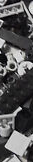


THE REGISTRAR’S OFFICE
LOOKING FOR THE BUILDING BLOCKS
What do you think of when you hear Registrar?
Mission Statement
Opportunities for Student Learning Outcomes
Degree audits meet the AACRAO and CAS standards for educating students.
THE CHALLENGES
Directive and No precedent for SLO’s for the Registrar’s Office
Faculty and Student Engagement

Slide 4


TUTORING SERVICES
BUILDING FROM THE GROUND UP
Mission Statement
Student Learning Outcomes
Quality of Tutoring Services Employees
More Assessment to come…..
CHALLENGES
Inherited staff members
No previous data
Notes:
How I used the group to discusses assessment ideas – collaborative approach
Assessment can be uncomfortable

Slide 5

ADVISING
EXPLORATORY STUDIES/UNDECLARED
BUILDING WITHOUT A BLUEPRINT
Mission Statement
Student Learning Outcomes
Advisement Meetings
CHALLENGES
The Lone Builder
Blueprint Addition
Notes:
Mention Collaboration

Slide 6


CENTER FOR ACADEMIC SUCCESS & ACHIEVEMENT
BUILDING A FOUNDATION
Mission Statement
SLOs
Workshops
Individual Appointments
CHALLENGES
Continuous Improvement
Initiative

Slide 7


ROHRBACH LIBRARY
BUILDING ON TRADITION
Mission Statement
Student Learning Outcomes
Information Literacy Sessions
CHALLENGES
Stakeholders in the Library
Updating previous plans to a new building code

Slide 8


MISSION STATEMENT:
The Center for Academic Success and Achievement (CASA) supports students in acquiring the knowledge and skills for achieving their educational goals.
What SLOs would be expected/appropriate?
Notes:
Its been a good exercise for individuals to go look at their assessment
Sharing is caring
Who here are using SLO’s in there practice
How many of you have experience writing SLO’s

Slide 9
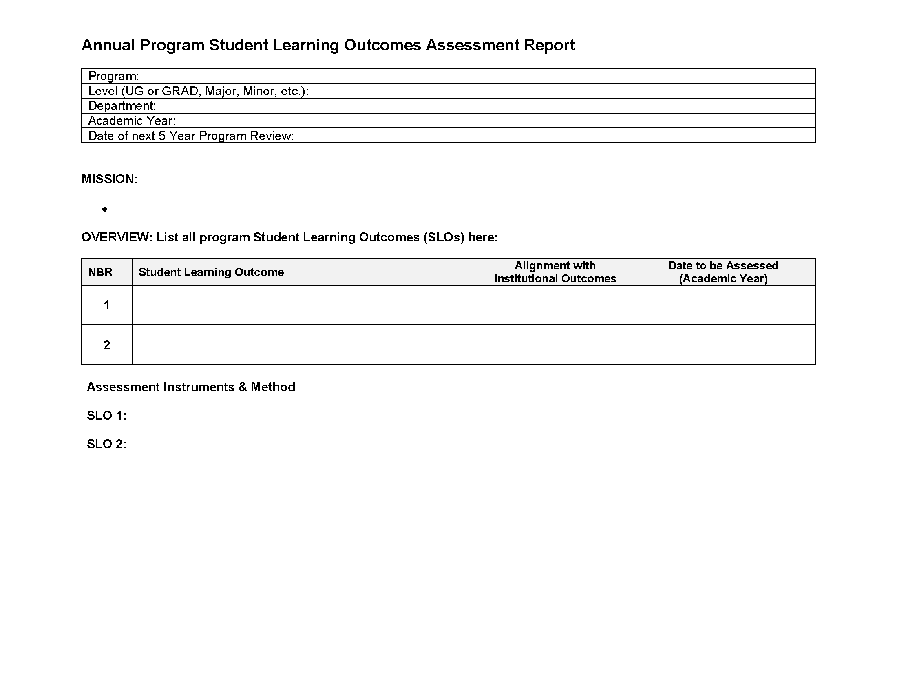

Slide 10
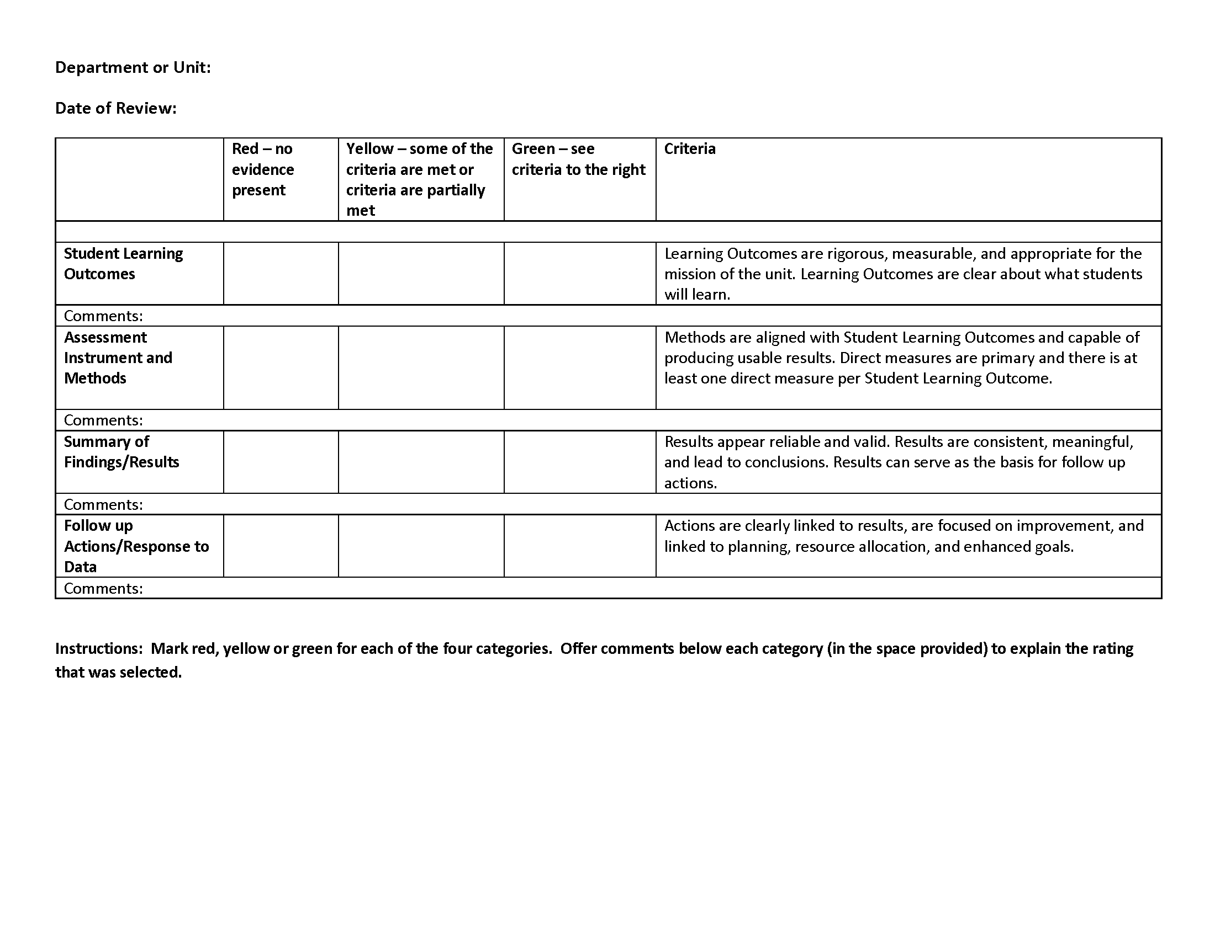
Notes:
Trade with group/person next to you
Discussion…..

Slide 11

QUESTIONS

Slide 12

Andrea Kirshman, D.Ed.
Associate Provost for Retention & Student Success
kirshman@kutztown.edu
Marlene Fares, M.Ed.
Academic Advisor for Exploratory Studies
fares@kutztown.edu
R. Chad Brown, M.A.
Assistant Director for Retention and Student Success
cbrown@kutztown.edu
Lori Lentz, M.Ed.
Assistant Registrar - Transfer & Graduate Students
lentz@kutztown.edu
Rachel Fager, M.L.I.S.
Technical Services Technician
fager@kutztown.edu

Slide 13



