Slide 1
ASSESSMENT – make it meaningful and manageable.
Kutztown University
January 17, 2023
Ruth Slotnick, Ph.D.
NILOA Endorsed Speaker
Bridgewater State University

Slide 2
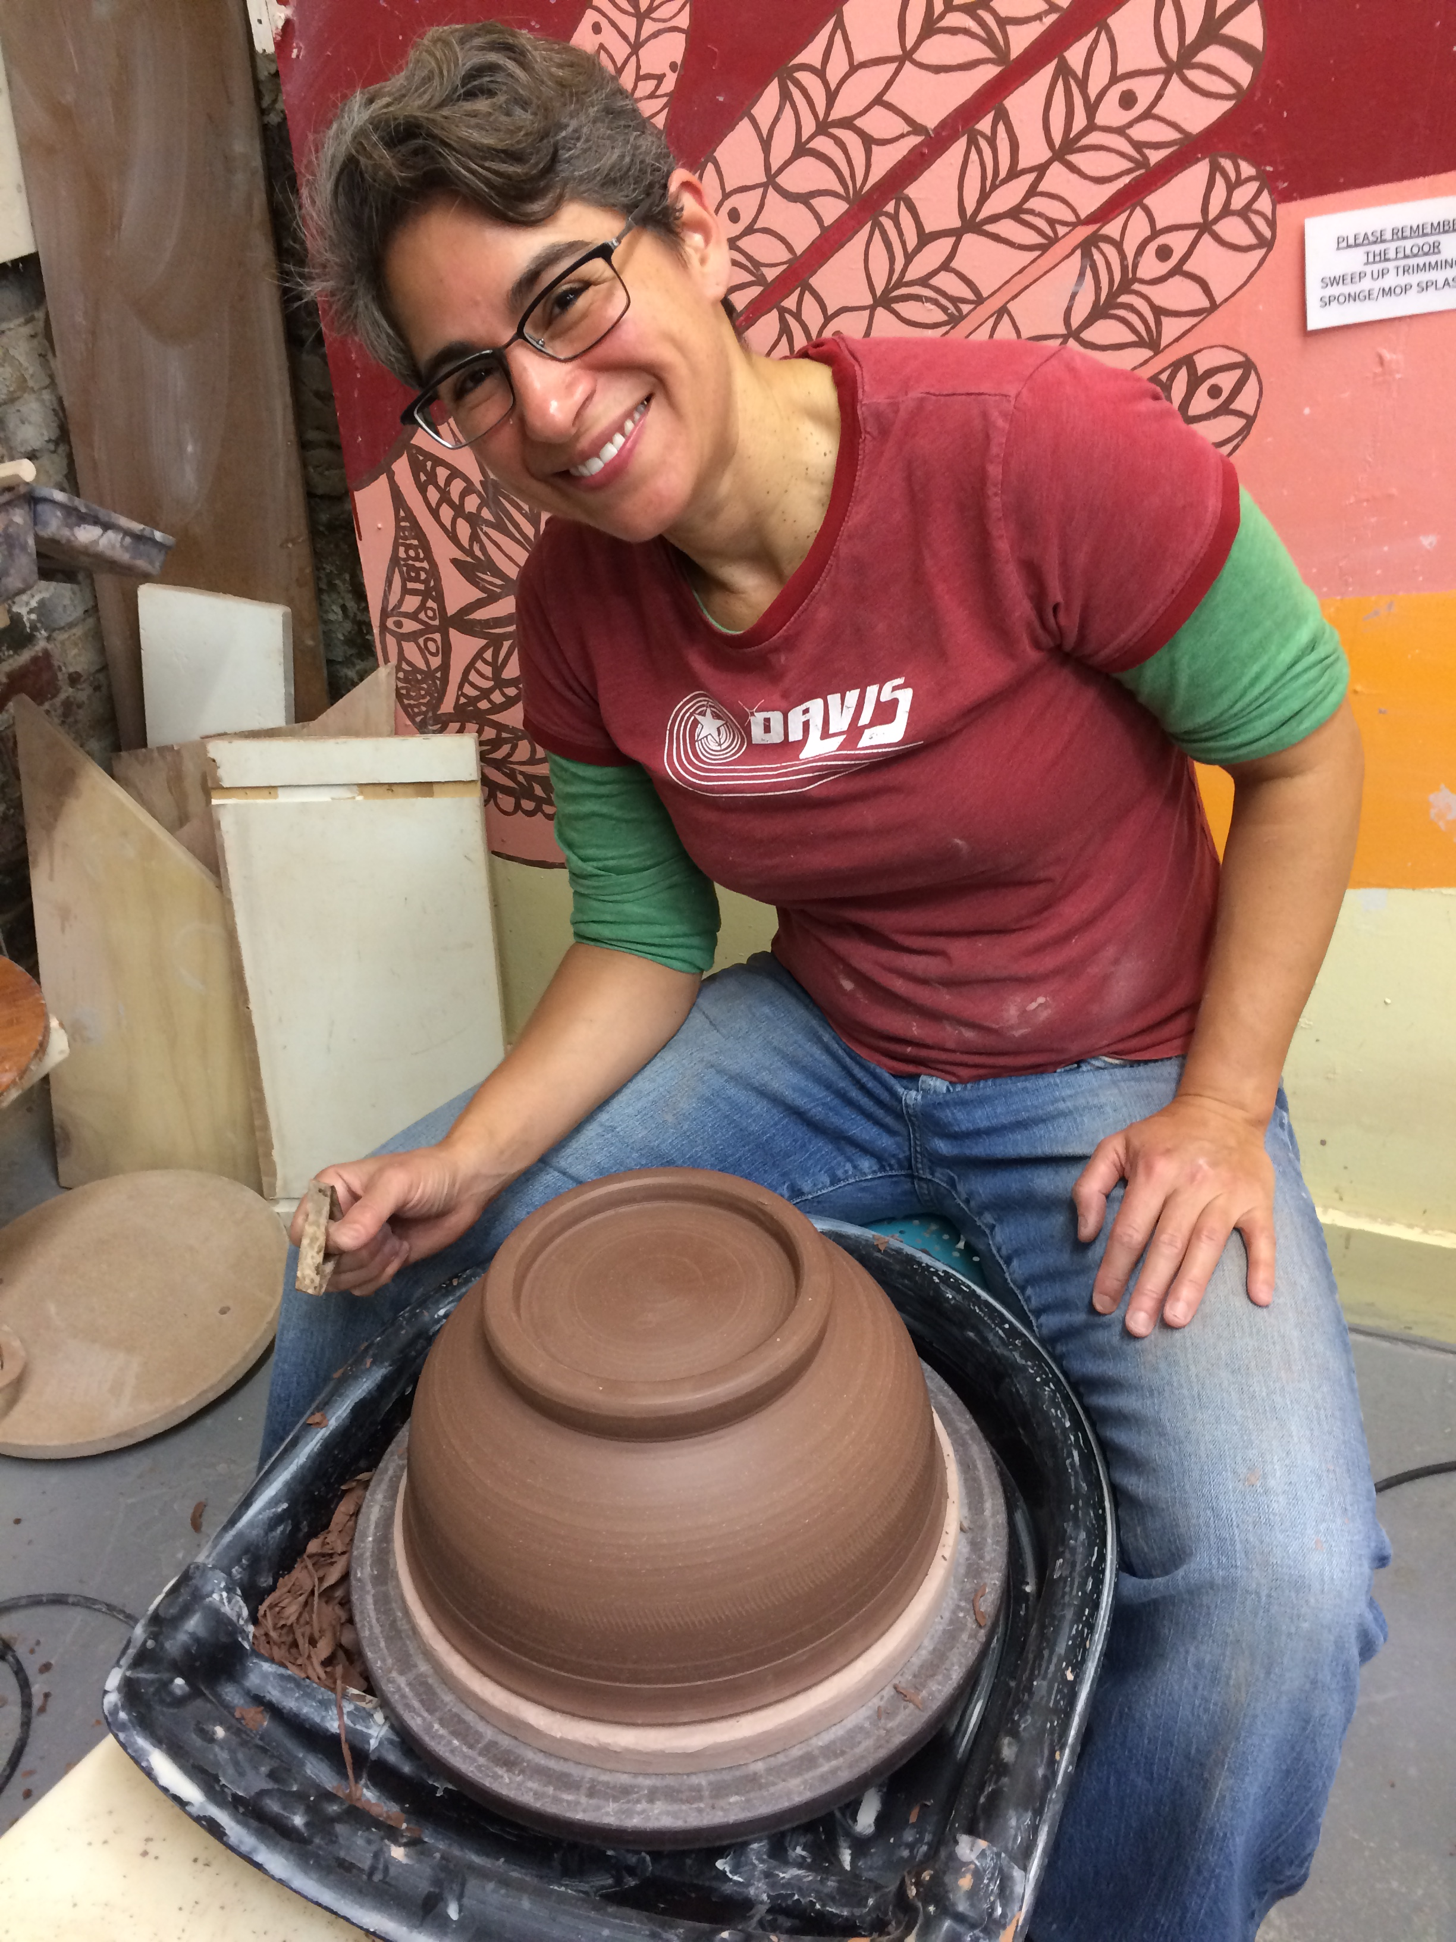
About me
Director of Assessment at BSU
MEd Art Education from Penn State
PhD in Higher Education from USF
Adjunct instructor, BSU in Higher Education, MEd program
Taught middle school art and theatre
Studio potter (my happy place)
From Lancaster, PA!

Slide 3

Source. https://www.archivalmethods.com/blog/art-carrying-cases-transport/

Slide 4
Why am I here?
To motivate you to do a little something in assessment that is useful to you, your academic program, and your students.

Slide 5
Workshop Structure:
Overview – 10 mins.
Three cases with feedback – 45 mins.
Wrap-up – few minutes

Slide 6
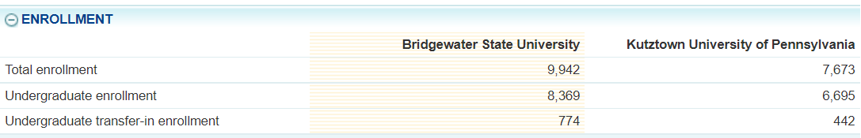
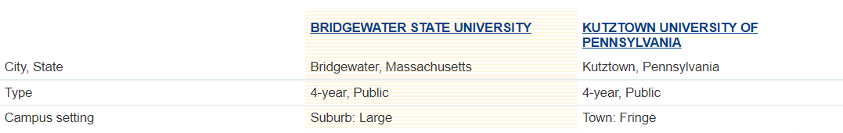
Overview
Kutztown and BSU are Peer Institutions
Source. College Navigator, https://nces.ed.gov/collegenavigator/

Slide 7
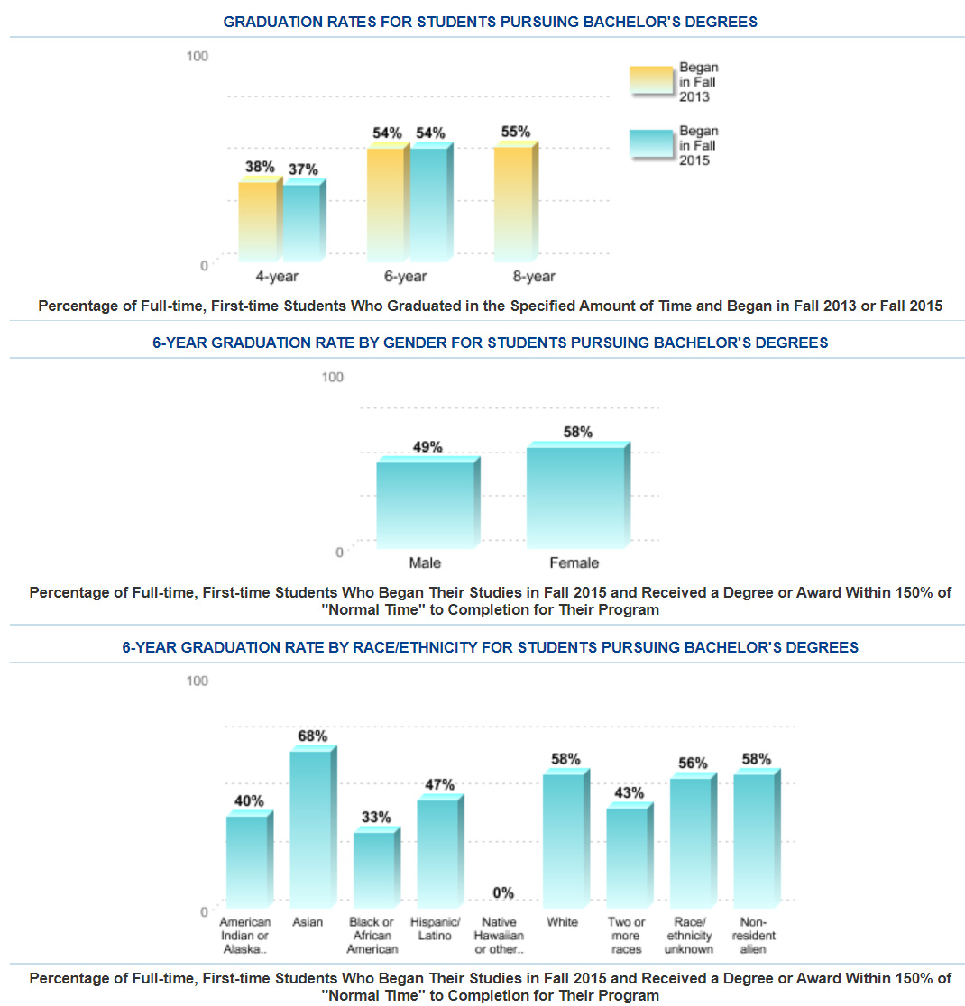
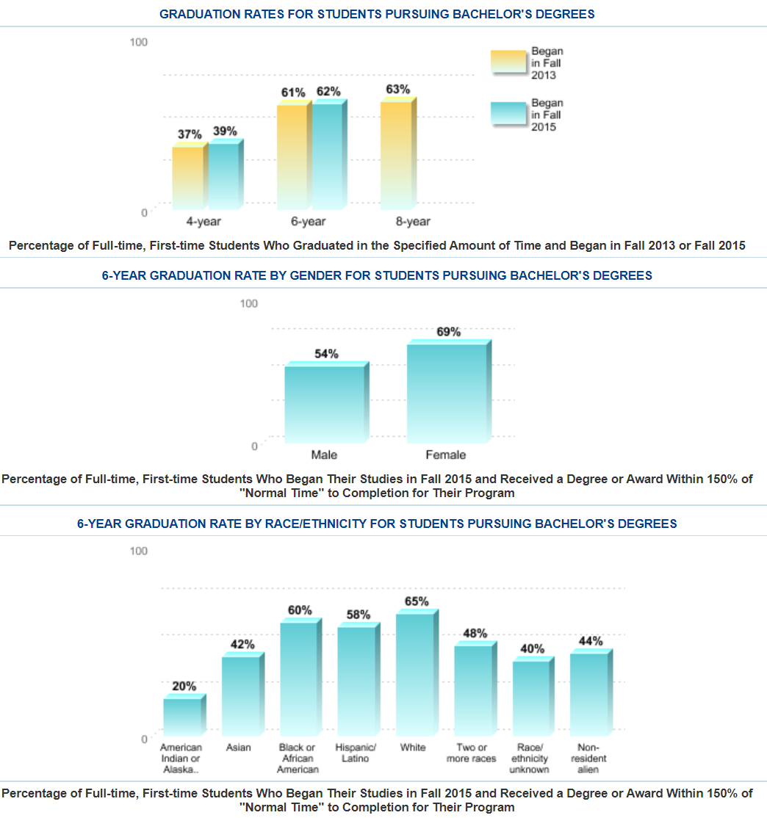
Overview
Kutztown
BSU
Source. College Navigator, https://nces.ed.gov/collegenavigator/

Slide 8
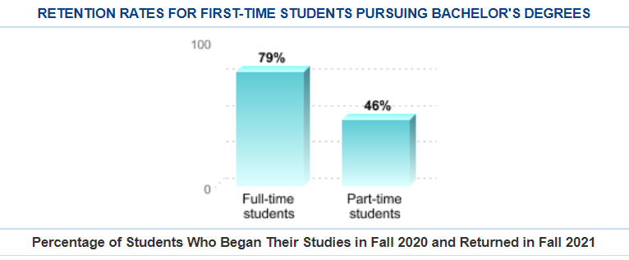
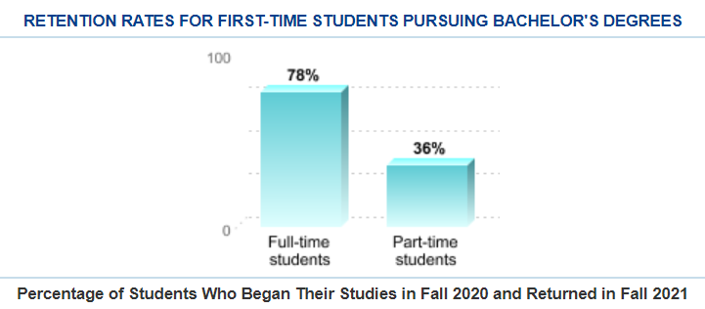
Overview
Kutztown
BSU
Source. College Navigator, https://nces.ed.gov/collegenavigator/

Slide 9
Let’s talk about assessment.

Slide 10
Overview
TELL YOUR PROGRAM STORY
Disciplinary Conventions
Program Outcomes
Program Assessment
Program Review
Institutional Mission
Student Success and Enrollment
Program Quality
Program Growth
STENGTHEN THIS RELATIONSHIP

Slide 11
Your role:
From actual cases: find some assessment strategies that might work for you that you can adapt or adopt. Two programs presented here, just successfully completed program review.

Slide 12
Your Feedback:
The feedback you offer is meant to be generative.

Slide 13
The Three Cases
Small, medium, large programs
Different styles of assessment reporting
Use direct and indirect results for meaningful program improvement

Slide 14

Case of Chemistry, BA/BS
“Integrated, established, useful”

Slide 15
Size of program: 76 majors
8 full-time faculty (6 tenured and 2 tenure-track)
5 full-time staff
8 part-time faculty
Case One

Slide 16
Chemistry’s Challenges
#1: How to align the departments program learning outcomes (PLOS), with the American Chemical Society’s (ACS) competencies, with the Council of Undergraduate Research (CUR) Universal Goals, and BSU strategic goals into one map?
#2: How to depict student progress on learning outcomes?
#3: How to integrate Diversity, Equity, and Inclusion?

Slide 17
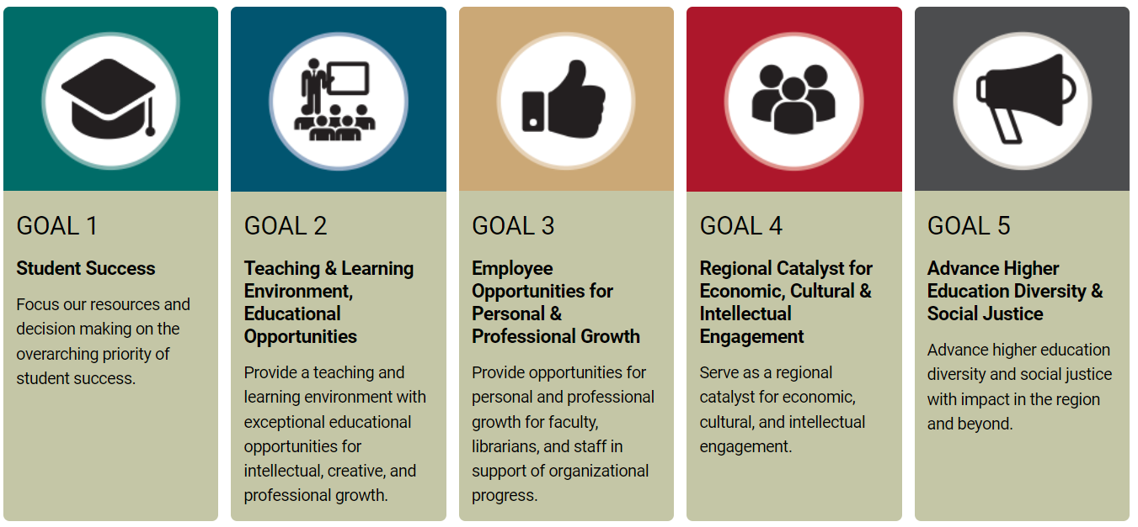
Chemical Sciences Student Learning Outcomes 2014-2015
Demonstrate working knowledge of chemical principles, including:
atomic and molecular structures
mass relationships (stoichiometry)
preparation of solutions
chemical equilibria, including acid-base, solubility and complex ion
2. Solve chemical problems by:
applying fundamental mathematics
integrating stoichiometry, volumetric analysis and measurement skills
3. Understand and apply the following skills in experimental design and analysis:
accurate preparation of solutions
accurate and complete record keeping
quantitative measurements and graphical analysis of data
CHEM Council of Undergraduate Research (CUR) Transformations Project (TP) Universal Learning Goals:
Knowledge
Formulate Questions
Formulate/Developing a Research Plan
Present Research
Critical Thinking
Ethical Conduct
Communication
Career Readiness
BSU Strategic Goals
American Chemical Society (ACS) – Student Skills, effective 2016
Experiment Design & Data Communication Skills
Communication Skills
Chemical Literature & Information Management Skills
Team Skills & Collaboration
Professional Conduct of Scientists
Practical Laboratory Safety Skills & Proficiencies
Case One

Slide 18
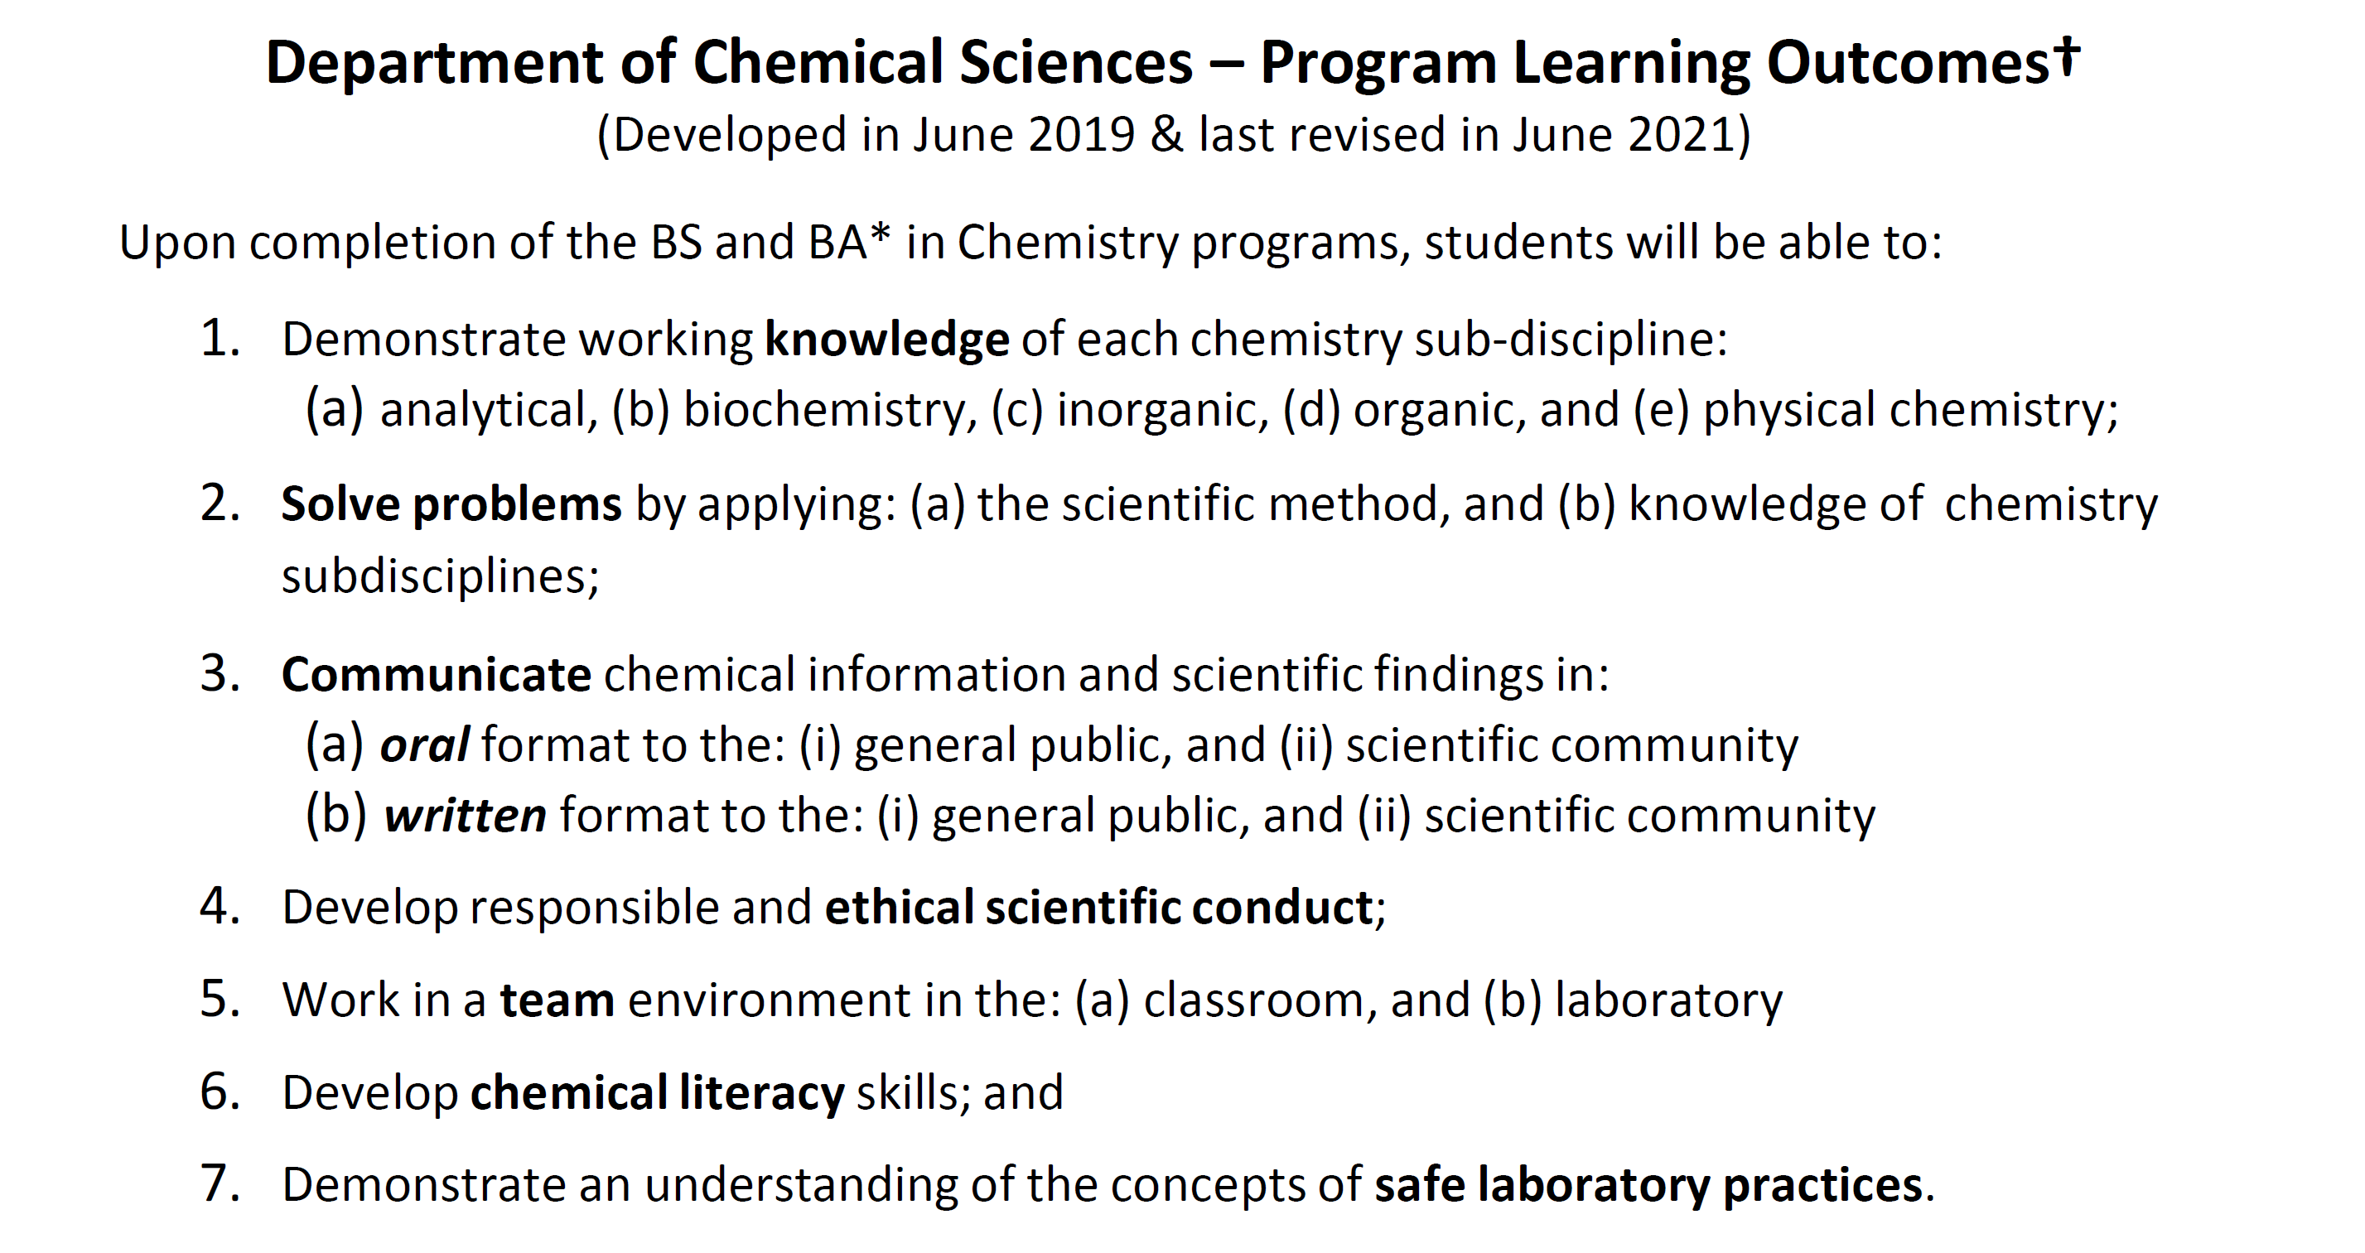
Revised Learning Outcomes
CHEM Council of Undergraduate Research (CUR) Learning Goal.
Knowledge
Formulate Questions
Formulate/Developing a Research Plan
Present Research
Critical Thinking
Ethical Conduct
Communication
Career Readiness
American Chemical Society (ACS) – Student Skills, effective 2016
Experiment Design & Data Communication Skills
Communication Skills
Chemical Literature & Information Management Skills
Team Skills & Collaboration
Professional Conduct of Scientists
Practical Laboratory Safety Skills & Proficiencies
Case One

Slide 19
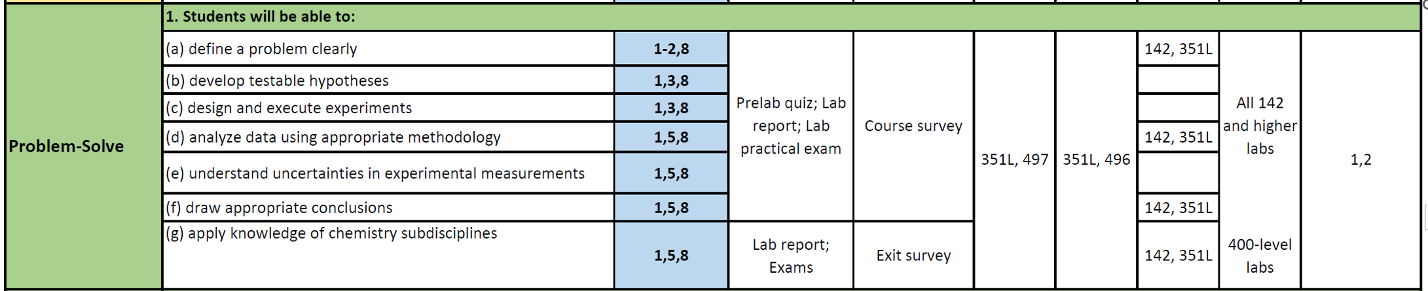
Alignment Grid
Embedding ACS Standards and CUR Goals
Program Review Year
1
Case One

Slide 20
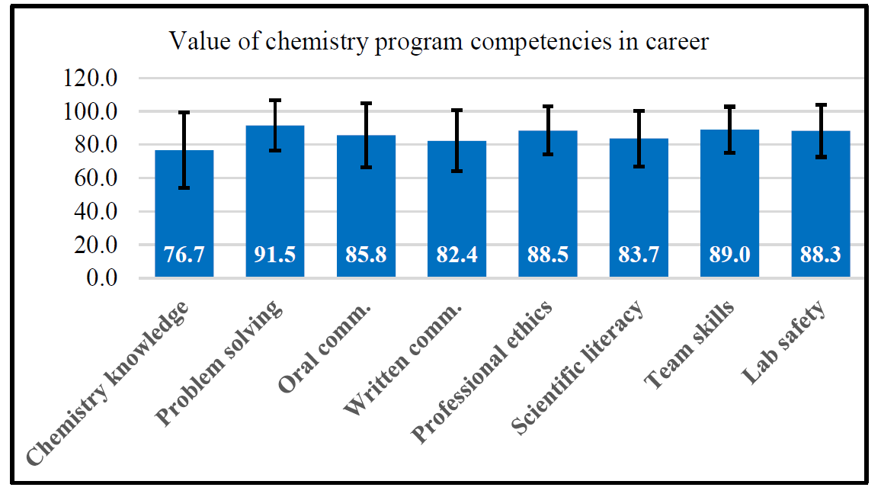
CHEMISTRY ALUMNI SURVEY – VALUE OF DEGREE
Figure. Data from alumni survey (N=36) conducted in Spring 2022.
Case One

Slide 21
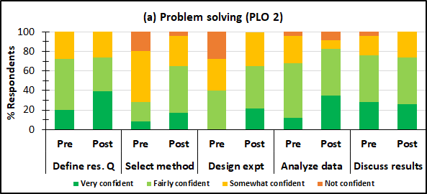
Pre-and post-course survey shows improvement
Figure. Results of intermediate-level chemistry (CHEM 351) pre-and post-course survey results in AY2021-2022.
Case One

Slide 22
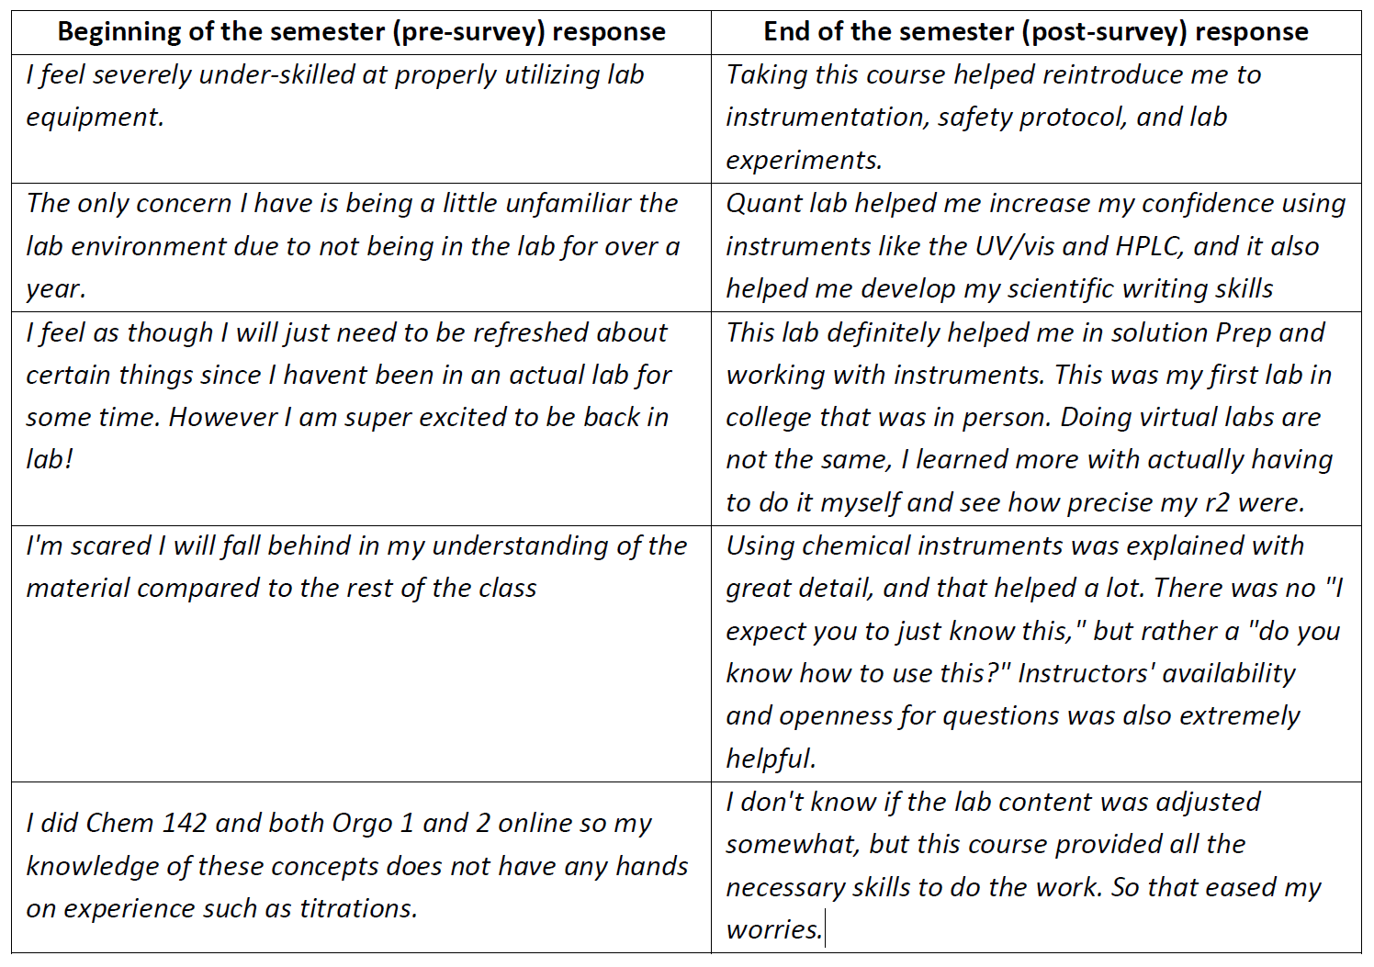
Pre-and Post-course Survey Open-ended Comments from Students
Pre-survey responses allow faculty to engage in discussion with students about their learning anxieties during the course but also tweak assignments in the course where necessary to underscore skills gained in the course to allay student fears of failure.
Post-survey responses allow faculty tweak assignments courses in CHM 496 to further reinforce students' skills.
Case One

Slide 23
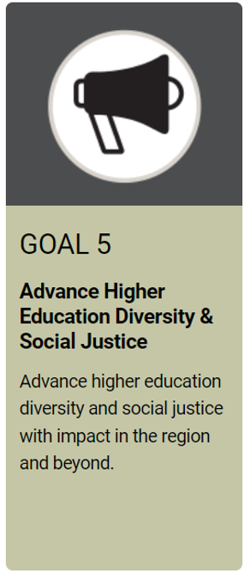
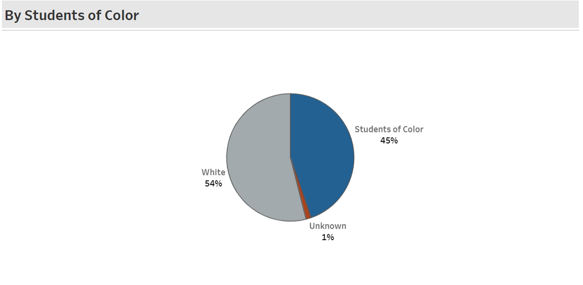
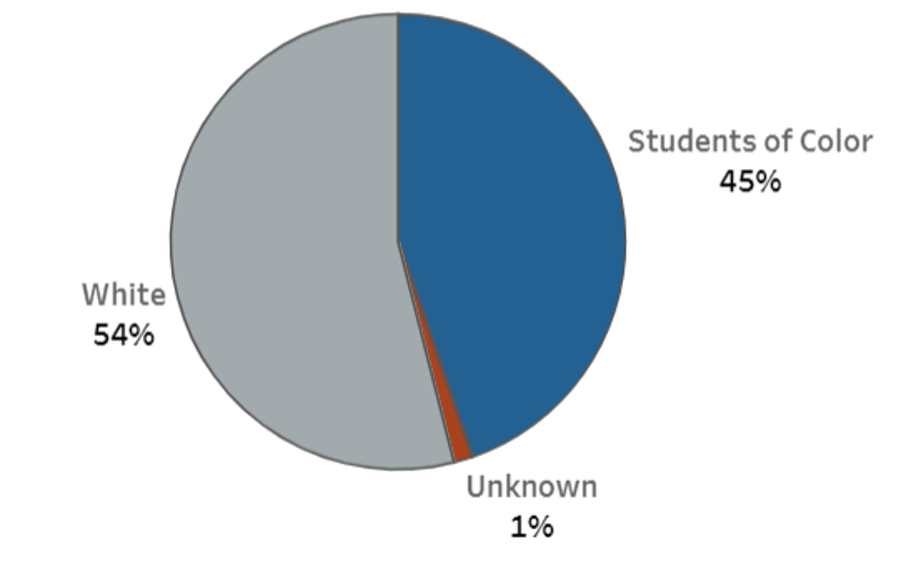
Current size of program: 76 majors
Case of Chemistry, BA/BS – Integrating DEIR
Tenured professor’s course syllabus:
As the “central science”, the field of chemistry is uniquely positioned to provide an understanding of, and contribute solutions to, complex global problems. To accomplish this, we must be able to effectively collaborate as a Team, with people who have diverse perspectives and life experiences in order to understand the challenges facing the world in the 21st century and develop and apply the strategies needed to help solve them. As part of this course, we will discuss what diversity, equity, inclusion and respect (DEIR) mean to each of us. Each student will develop their own DEIR statement and decide whether you want to include it in your resume.
AY22-23 Assessment Goal
Engage the department in discussions of curriculum and programmatic changes that explicitly address diversity, equity, inclusion and respect (DEIR), student voice, and methods of assessing their impact on student learning.
Case One

Slide 24
Chemistry BA/BS - Assessment Strategies
Alignment grid to show integration of standards, timeline, assessment methods
Data visuals to depict student progress
Focus on integrating of DEIR into curriculum

Slide 25
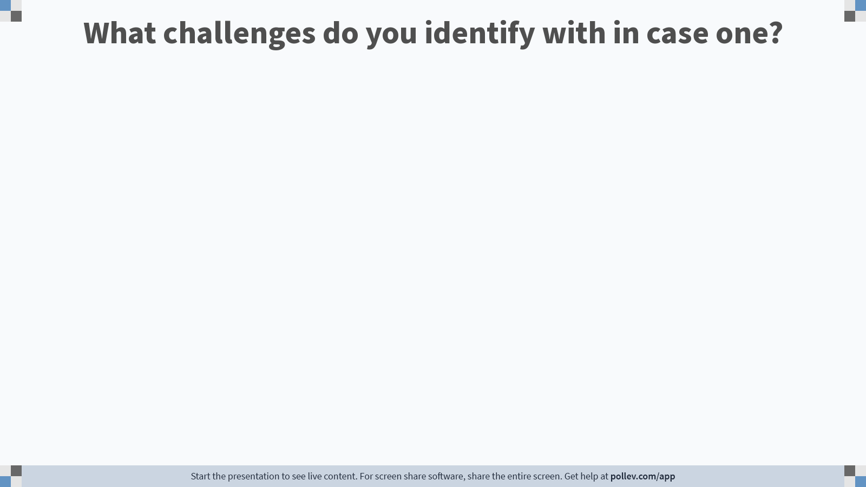
Notes:
Poll Title: Do not modify the notes in this section to avoid tampering with the Poll Everywhere activity. More info at polleverywhere.com/support What challenges do you identify with in case one? https://www.polleverywhere.com/free_text_polls/MYHg4eoEflroR2zp3wKbJ

Slide 26
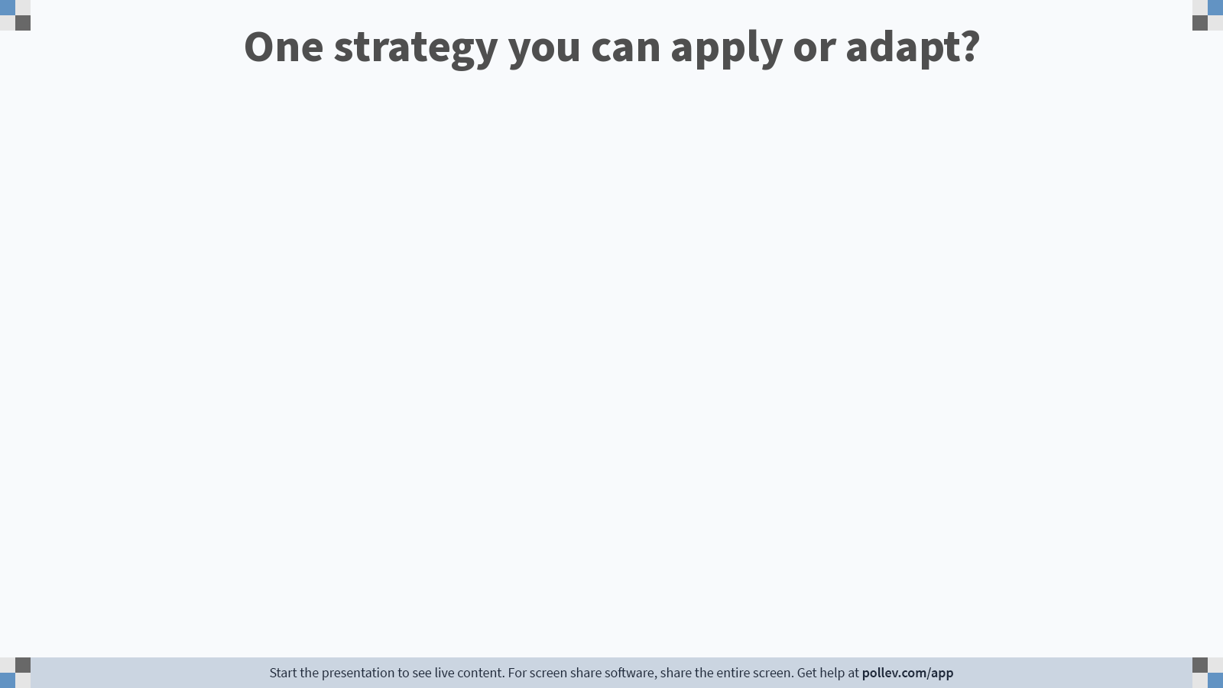
Notes:
Poll Title: Do not modify the notes in this section to avoid tampering with the Poll Everywhere activity. More info at polleverywhere.com/support One strategy you can apply or adapt? https://www.polleverywhere.com/free_text_polls/fz8zmGBSBCim0KgHf09j1

Slide 27
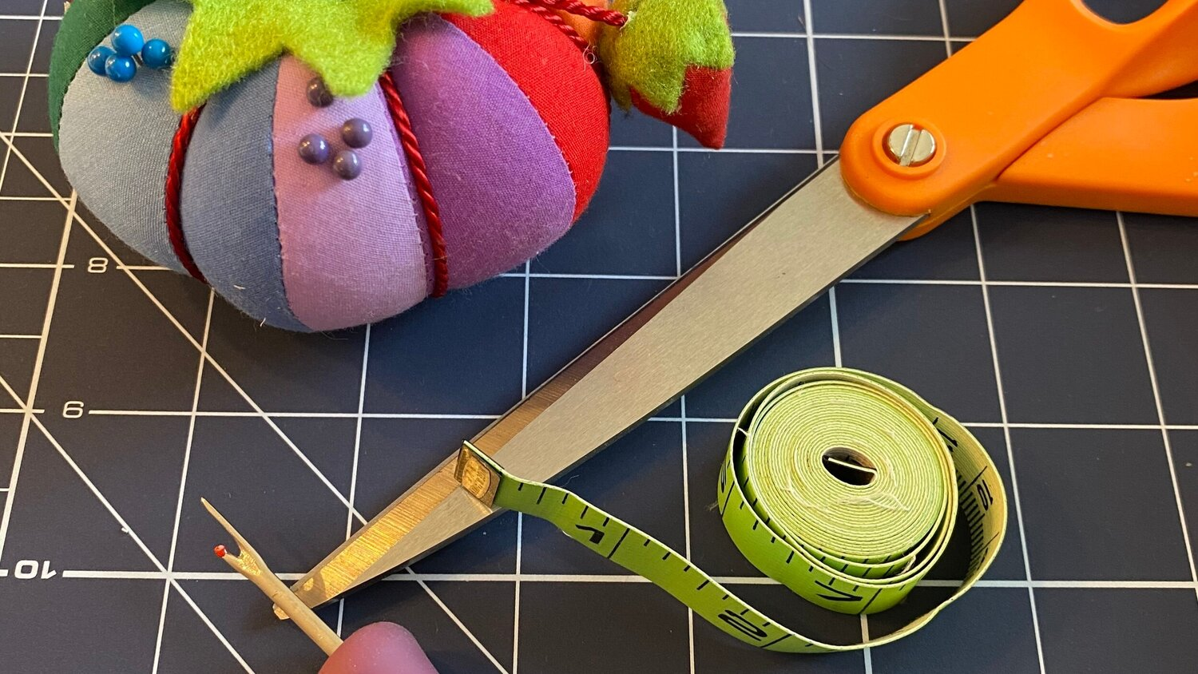
Case 2: Case of Reading, MEd.
“Measure once, report twice”
Size of program: 26 majors
2 Full-Time Faculty
BSU requires:
Alignment to mission and strategic plan
Where outcomes are visible?
Assessment plan
How program is using results for student improvement of its graduates
Source. https://www.coreallies.com/blog/measure-twice-cut-once

Slide 28
Reading’s Challenges
#1: How to show Reading’s assessment system and alignment to the BSU strategic plan?
#2 How to translate the requirements of the International Literacy Association (ILA) standards results collected annually, for BSU’s annual assessment requirements?
Case Two

Slide 29
BSU Strategic Goals
Reading Program Aligned Program Goals to BSU Strategic Goals
Goal 1: Develop students’ core competencies in reading intervention and mentoring of teacher colleagues.
Goal 2: Embed pre-practicum opportunities throughout the program that allow graduate students to implement theory as part of their instructional practice with on-going feedback and reflection.
Goal 3: Engage in a Professional Learning Community (PLC) as a way to build collective efficacy and scholarship among colleagues.
Goal 4: Serve and support the local community as agents of change through research and presentation.
Goal 5: Integrate the diversity and equity standard from ILA standards for reading professionals across all course work and professional practice among faculty.
Case One

Slide 30

Reading, MEd.
Translating the requirements
Distillation and Alignment Grid
BSU Strategic goals
ILA
Case Two

Slide 31
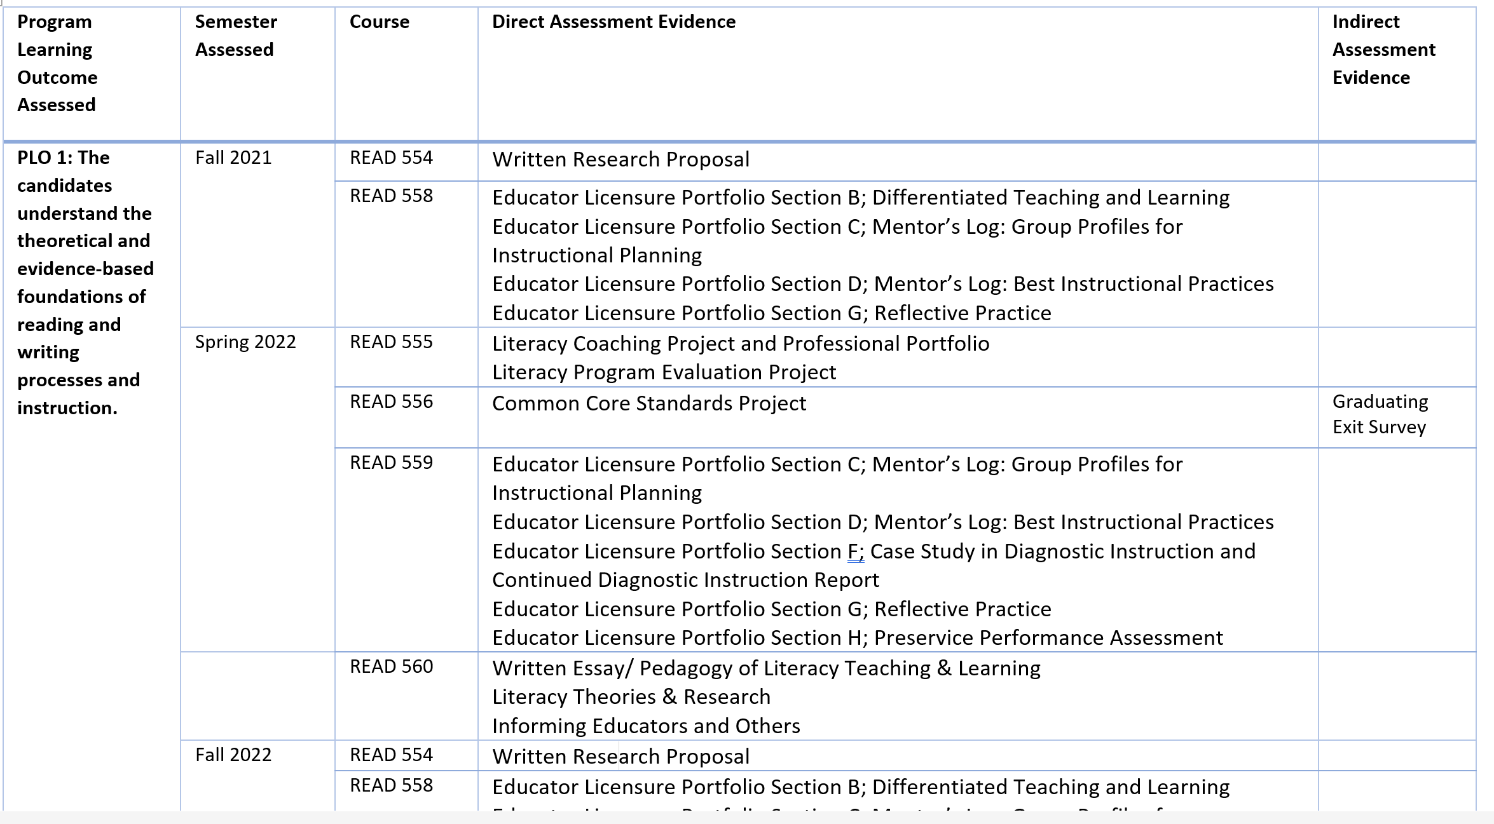
Reading, MEd.
Translating the requirements
Map of Assessments by Program Outcome
Required by ILA
Practicum
Experience I
for the Reading
Specialist
Case Two

Slide 32
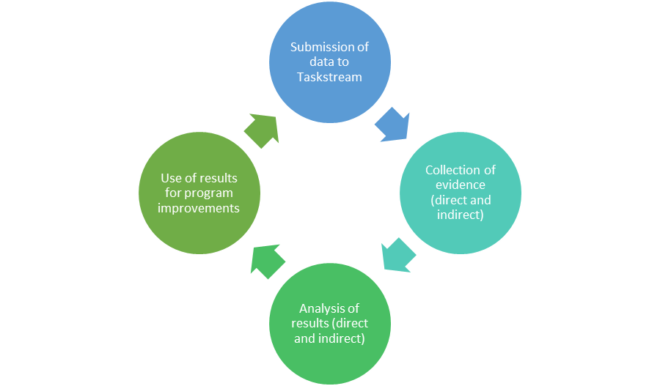
Translating the requirements
Required assignments to meet ILA standards
MEd
Reading Assessment Cycle
Including any additional assessments created by the program (e.g., exit survey)
Shared with faculty in program for discussion.
Case Two

Slide 33
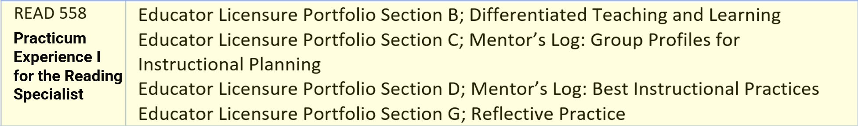
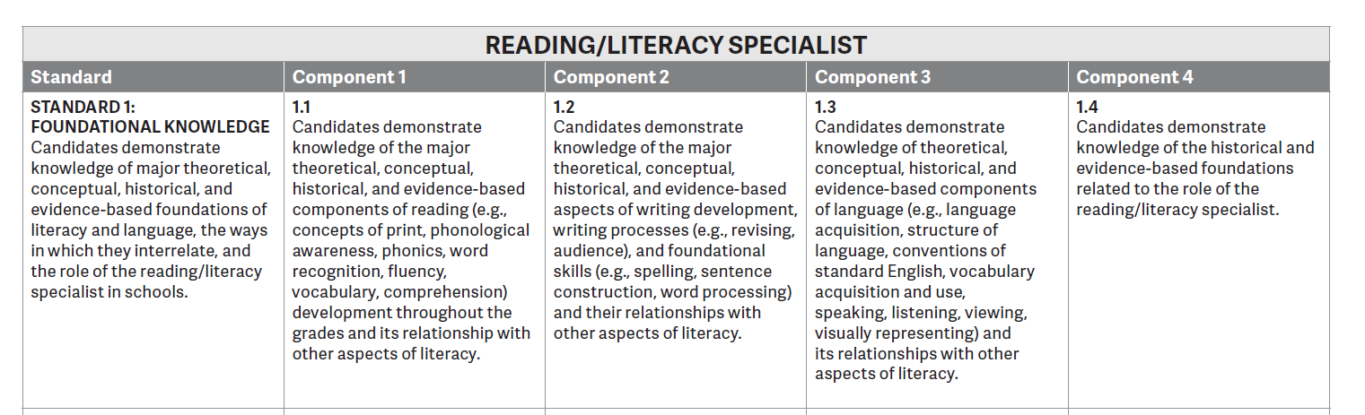
Reading, MEd. – Communicating Results
This is the first time in three years where student performance on PLO 1 is at the mastery level due to regular assessment feedback and action steps taken.
Fall 2021 Data for READ 558: Practicum Experience I for the Reading Specialist
READ 558- ASSESSMENT 4 PART B- 5 Lessons as a Unit
Standards in the Acceptable to Target Range
1.1, 1.3, 2.1, 2.2, 2.3, 3.3, 4.1, 4.2, 4.3, 5.1, 5.2, 5.3, 5.4, 6.2
READ 558- ASSESSMENT 4 PART C- Mentees Classroom Data
Standards in the Acceptable to Target Range
1.1, 1.3, 2.1, 2.2, 2.3, 3.1, 3.2, 3.3, 4.1, 4.2, 4.3, 5.2, 5.4, 6.2, 6.3
READ 558- ASSESSMENT 4 PART D- Mentee Log
Standards in the Acceptable to Target Range
1.1, 1.3, 2.1, 2.2, 2.3, 3.1, 3.2, 3.3, 4.1, 4.2, 4.3, 5.1, 5.2, 5.3, 5.4, 6.1, 6.2, 6.3,
READ 558- ASSESSMENT 4 PART E- Workshop for Families
Standards in the Acceptable to Target Range
1.1, 1.3, 2.1, 2.2, 2.3, 3.1, 3.4, 4.1, 4.3, 6.1, 6.2, 6.3
READ 558- ASSESSMENT 4 PART G- Reflective Journal
Standards in the Acceptable to Target Range
1.1, 1.3, 2.1, 2.2, 2.3, 3.1, 4.1, 4.3, 6.1, 6.2, 6.3, 6.4
Case Two

Slide 34
Reading, MEd. – Process of Indirect Assessment
Walvoord (2010) recommends the following survey questions for an indirect measure (p. 60):
How well did you achieve each of the following departmental goals? (list each department goal, with a scale for each).
What aspects of your education in this department helped you with your learning, and why were they helpful?
What might the department do differently that would help you learn more effectively, and why would these actions help?
Case Two

Slide 35
Reading, MEd. – Process of Indirect Assessment
Includes three important questions:
What aspects of your education in the Master's in Reading program helped you with your learning, and why were they helpful?
What might the Master's in Reading program do differently that would help you learn more effectively, and why would these actions help you?
In what ways has the Master's in Reading program benefited you in your professional life?
Adopted from Walvoord, 2010
Exit Surveying Started in 2018
Adopted from Walvoord, 2010
Case Two

Slide 36
Reading, MEd. – Process of reviewing results
Faculty review student comments for the open response survey questions for trends in student feedback.
Identified trends are used to target improvements in the program, coursework, and assignments.
Case Two

Slide 37
Example of Using Indirect Assessment Results
Trends for open response: “What might the Master's in Reading program do differently that would help you learn more effectively, and why would these actions help you?”
Repetition of assignments in practicum
Departmental Response: After reviewing the Qualtrics data from the exit survey the faculty identified the need to restructure the yearlong practicum to avoid redundancy in assignments/ course work.
Case Two

Slide 38
Reading, MEd. - Assessment Strategies
Alignment grid to show integration of standards, timeline, assessment methods
Map of assessments
Cycle of assessment
Narrative of student results
Integrated an exit survey for trend analysis
Case Two

Slide 39
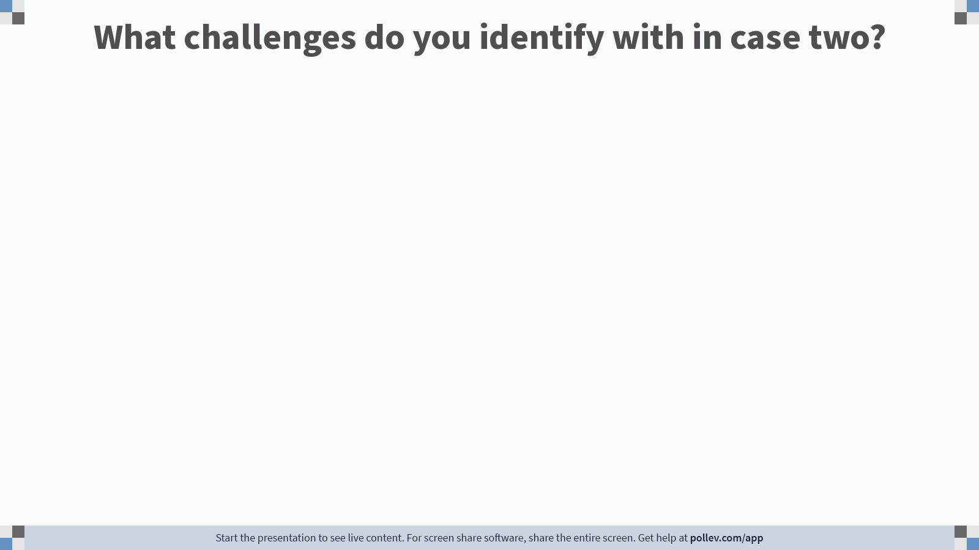
Notes:
Poll Title: Do not modify the notes in this section to avoid tampering with the Poll Everywhere activity. More info at polleverywhere.com/support What challenges do you identify with in case two? https://www.polleverywhere.com/free_text_polls/gcFR4rtgWuNRb5mqrqV9P

Slide 40
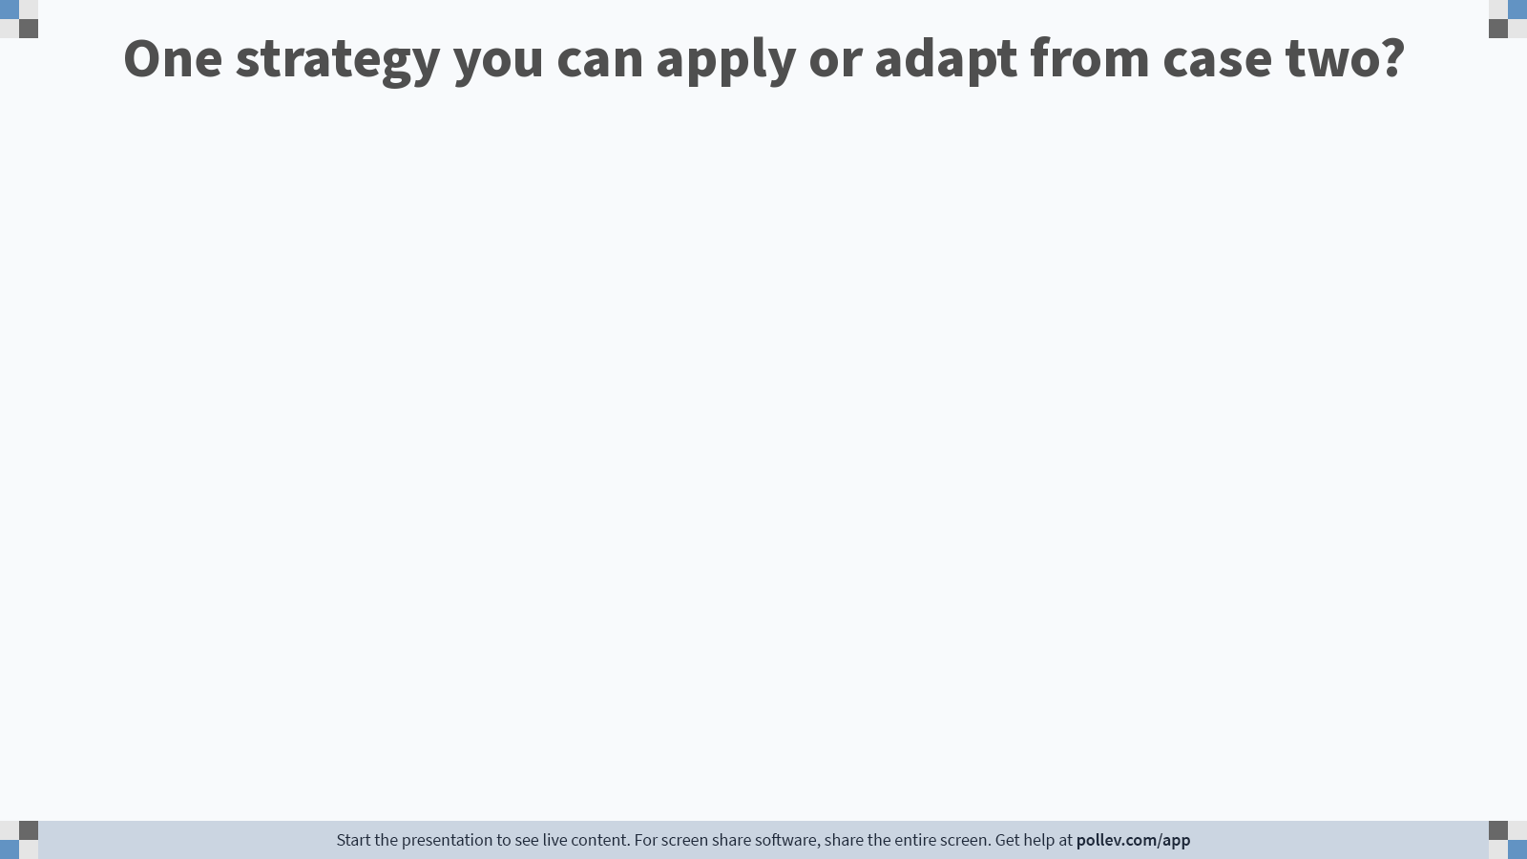
Notes:
Poll Title: Do not modify the notes in this section to avoid tampering with the Poll Everywhere activity. More info at polleverywhere.com/support What challenges do you identify with in case one? https://www.polleverywhere.com/free_text_polls/JM0Vi4p7nydQVVYWT3x56

Slide 41

Case 3: History, BA
“Closing the loop”
Size of program: 308 majors
13 Full-Time Faculty Members

Slide 42
History’s Challenges
#1: Is the proseminar improving identified students’ skills?
#2: Closing the loop - does assessment improve student learning?
Case Three

Slide 43
History, BA
History Program Learning Outcomes:
Identify and describe multiple causes and consequences of political, social, economic, and cultural change over time [CAUSALITY AND COMPLEXITY]
Locate, collect, and evaluate evidence from a variety of primary and secondary sources in print and electronic media. [EVIDENCE]
Develop and frame historical arguments in clear and correct prose within the context of the discipline’s literature. [ARGUMENT]
Distinguish the universal from the particular and historically contingent in human experience.
Case Three

Slide 44
History, BA
Summary Chart: Assessment Cycle and Use of Results
 | AY 14-15 | AY 15-16 | AY 16-17 | AY 17-18 | AY 18-19
Assessed | SLO 2 Evidence | SLO 3 Argument | SLO 1 Causality and Complexity | SLO 2 Evidence | SLO 3 Argument
Use | Designed proseminar syllabus | Refined assignments | Refined class discussions | Shaped next assessment plan | Refined assignments
Loops
Case Three
Notes:
Goal: We returned to assessing this outcome (previously assessed in AY 20152016) because we found in our 2017-2018 assessment that argumentation remained a significant challenge for students, even after their completion of the proseminar. We sought to evaluate argumentation in upper-level students’ work, in comparison with student argumentation in the lower-level proseminar.

Slide 45
History, BA – Closing the Loop
Key Findings for Evidence Comparison 2015 to 2018:
Student work had generally improved since 2014-2015 suggesting that the proseminar was beginning to achieve its goals in honing student research skills.
Most markedly, student ability to use the library and electronic resources to locate primary and secondary sources had improved.
Students were also more adept in integrating their analysis of primary and secondary sources.
Most students remained reluctant to engage in historiographical criticism, however, or to make a point from primary source evidence that differs from those made by professional scholars.
Case Three

Slide 46
History, BA – Closing the Loop
Key Findings for Argument Comparison 2016 to 2019:
More advanced students produced more specific and analytical arguments than proseminar students.
Students at both levels were generally able to craft the most solid arguments—making clear points, rooted in evidence—in response to specific prompts that asked them to take sides in clearly-defined debates, or to argue what happened and why.
When students had wide scope in their choice of topic—particularly in the capstones, where students often have the opportunity to design a research project—student performance ranged more broadly.
When faculty required submission of multiple drafts in research papers on topics that students chose, student argumentation improved.
Case Three

Slide 47
History, BA – Benefits of the Assessment System
Impact of Assessment:
The assessment underscored how deeply our students need structure, feedback, and space for self-reflection to cultivate their scholarly voices.
These insights motivated faculty to include more explicit rubrics and workshopping opportunities in our courses.
At subsequent faculty meetings, the department has also been engaged in ongoing discussion about how to add more structure and space for workshopping at the departmental level. Possibilities discussed include student e-portfolios, in which students choose, reflect upon, and share their best historical writing at each level of the program.
Case Three

Slide 48
History, BA
Feedback from External Reviewer
Commendation: The faculty demonstrate an impressive commitment to teaching innovative classes while paying attention to the assessment of learning outcomes, making constant improvements in the curriculum.
Recommendation: The department should continue existing practices such as clear statements about learning outcomes that underscore the importance of History as a discipline: students develop skills and perspectives that help them to be better-informed as citizens and human beings.
Case Three

Slide 49
History, BA
Recommendations from 400-Level Students
Create a list of courses at least two weeks before registration begins, so students can plan their schedules.
Increase diversity in terms of faculty, assigned readings (primary and secondary sources), and topics.
Let students see themselves reflected across the curriculum for greater relevance.
Be more intentional about assignments and communicate that to students.
Create online resources or compile links around writing and information literacy.
Develop a workshop on career counseling, how to market yourself, what you can do with the history major. Not everyone wants to be a high school teacher! This could be included as part of the proseminar.
Case Three

Slide 50
History, BA - Assessment Strategies
Summary chart of assessment timeline
Explanation of assessment process
Revising assignments and reassessing
Using results to possibly change assessment of student learning (e.g., E-portfolios)
Case Three

Slide 51
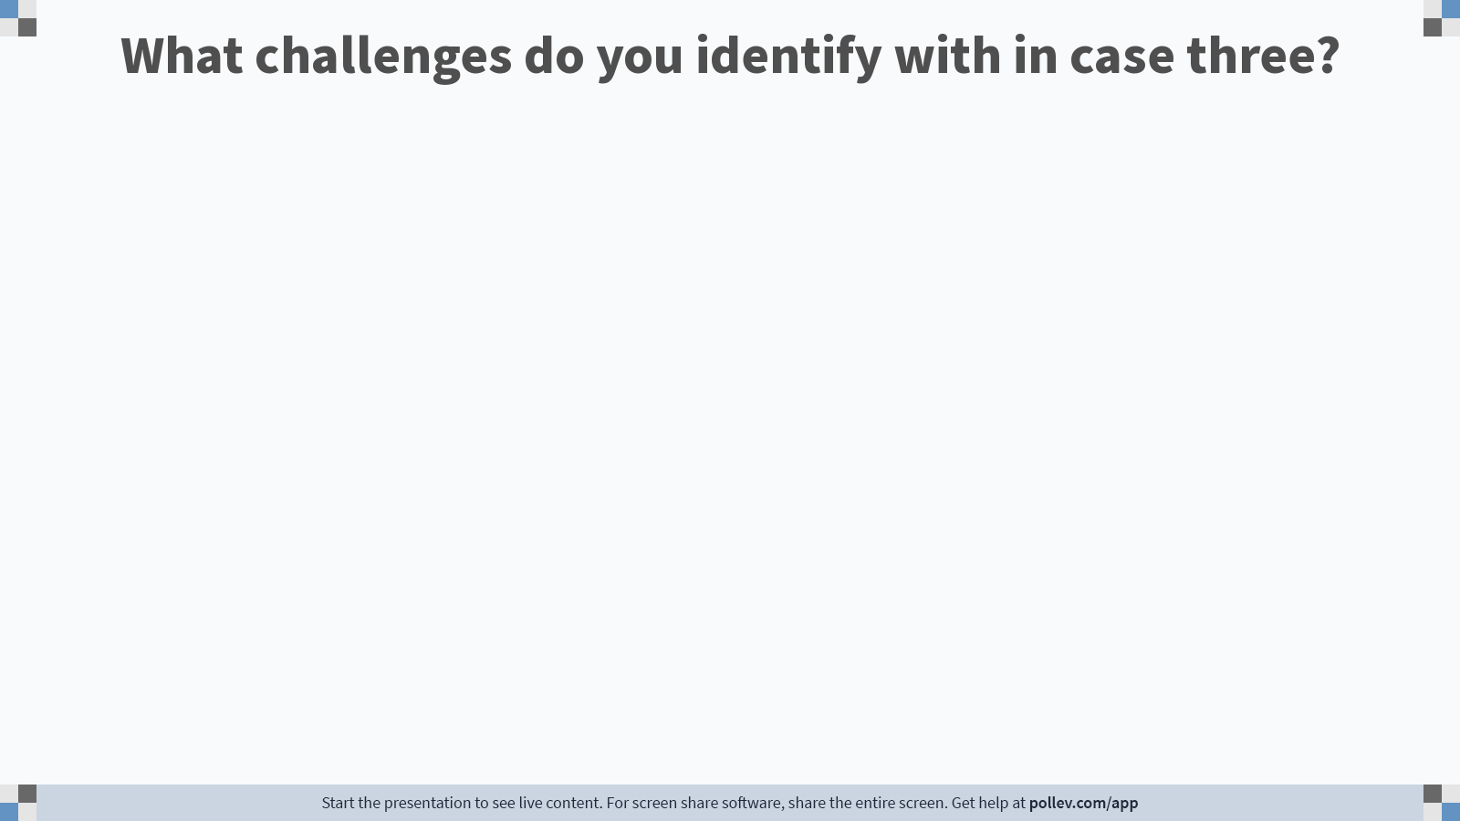
Notes:
Poll Title: Do not modify the notes in this section to avoid tampering with the Poll Everywhere activity. More info at polleverywhere.com/support What challenges do you identify with in case three? https://www.polleverywhere.com/free_text_polls/8iDFzUMDEPVMESaWKSEJY

Slide 52
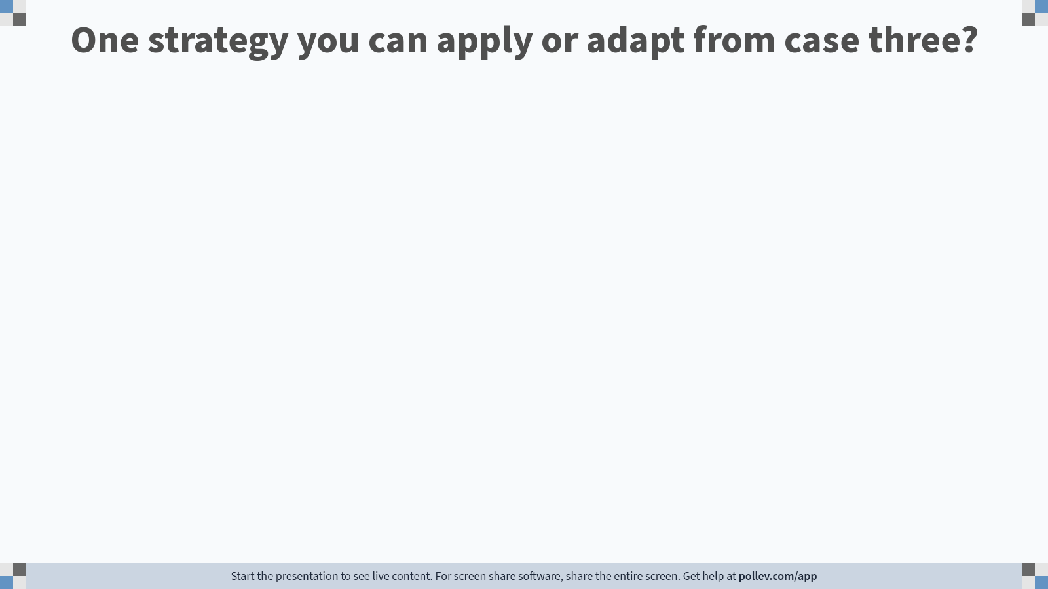
Notes:
Poll Title: Do not modify the notes in this section to avoid tampering with the Poll Everywhere activity. More info at polleverywhere.com/support One strategy you can apply or adapt from case three? https://www.polleverywhere.com/free_text_polls/8jvvITaFxeW31IpzDPG8V

Slide 53
Wrap-up
TELL YOUR PROGRAM STORY
Program Outcomes
Program Assessment
Program Review
Institutional Accreditation
Specialized Accreditation
DEI Integration
Systematic
Evidence-based
Transparency
Results Oriented
Program Growth
Reinforcement
Using Results
Program Needs

Slide 54
References
Walvoord, B. (2010). Assessment clear and simple. Jossey Bass, CA.

