Slide 1
Writing Program Learning Outcomes (PLOs)
Best Practices

Slide 2
Introductions
Welcome
Nicole Romanski, Ph.D. – Art Education & Crafts
Kathleen Stanfa, Ph.D. – Special Education

Slide 3
Learning Outcomes for Today’s Session
At the end of today’s workshop, participants should be able to do the following:
  Distinguish among course, program, and institution learning outcomes
  Evaluate the soundness of a PLO
  Revise PLOs so that they are succinct, specific, and assessable
  Write an assessable program learning outcome for your discipline

Slide 4



What Are Student Learning Outcomes?
The knowledge and skills students are required to demonstrate at the end of a learning unit.

Slide 5
What Student Learning Outcomes are NOT:
Inputs (e.g., readings, lectures, experiential exercises, internships)
Student achievement outcomes (e.g., post-grad employment, graduate school admission, student-authored publications)
Program goals (e.g., increase course offerings, earn programmatic accreditation, improve retention and graduation rates of majors)
Self-reports (i.e., students’ reports of how much they learned about X)
Notes:
Inputs: The educational experiences designed to generate learning (e.g., what students will read)
Attendant-educational outcomes: The desired consequences that may result from completing an educational program (e.g., getting a job, gaining entry into a graduate program, being an informed citizen)
Self-reports: Students’ judgements about their own learning

Slide 6
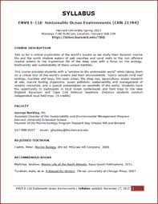


3 levels
CLO’s
PLO’s
ILO’s

Slide 7
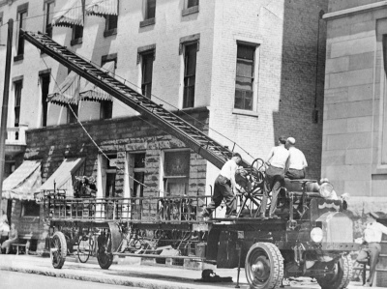
“Hook” and “Ladder”

Slide 8
The “Hook”
Students who successfully complete [name the program] should be able to do the following:

Slide 9
Hook Examples
Hook Examples
Upon the successful completion of General Psychology, students should be able to do the following:
Graduates from the B.S. in Computer Science program at Kutztown University should be able to do the following:
Those who earn an undergraduate degree at KU should be able to:
CLO hook
PLO hook
ILO hook

Slide 10
The “Ladder”
List of skills and knowledge

Slide 11
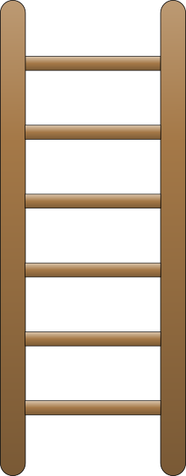
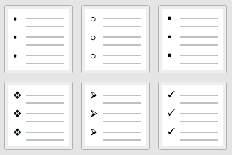
Ladder
Visual reminder; Not a hierarchy
Notes:
I call it a ladder as a visual reminder of a bullet-pointed list. The term “ladder” is not meant to imply a hierarchy or progression of skills.

Slide 12
For each rung to be assessable,
it needs to meet two
necessary & sufficient
criteria:

Slide 13
Assessable PLOs
Observable
Focused

Slide 14
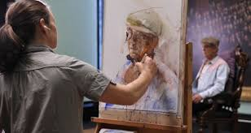
Criterion 1: Observable
Notes:
Starts with a verb that describes an action the student will engage in that a fac member can see or hear at a particular moment in time
If a faculty member can’t see or hear it, he or she can’t assess it.

Slide 15
Skills
Perform a monologue
Mix chemicals
Create a lesson plan
Sing an aria
Build a robot
Write a press release
Program a computer
Compose an original jazz score
Prepare a financial statement
Take a client history

Slide 16

What is inside the student’s head is not directly observable to the faculty member

Slide 17

Examples of Non-observable Verbs
Become familiar with
Be knowledgeable about
Think
Value
Realize
Become aware of
See
Know
Learn
Understand
Comprehend
Appreciate
Study
Experience
Avoid these!

Slide 18






Slide 19
Examples of Observable Verbs
To Assess Students’ Knowledge
Describe
Explain
List
Present
Write
Formulate
Create
Analyze
Arrange
Critique
Synthesize
Predict

Slide 20
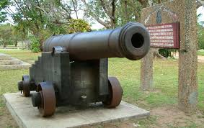
Criterion 2:
Focused
*
*One action

Slide 21
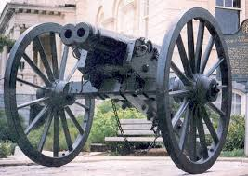
Double-Barreled
Students who earn a degree in German should be able to write and speak fluent German.
Notes:
Just like a survey item. You’ve had the experience of a survey that asks you something like, to what degree was the teacher helpful and the class interesting? Well, if the teacher was helpful but the class was boring, you’re stuck on how to answer the question. It’s exactly the same principle with double barreled SLOs. Your measurement will conflate two things creating ambiguous results.

Slide 22

Requirements
Describes an action that’s observable
Focuses on one action only, sufficiently broad yet specific

Slide 23
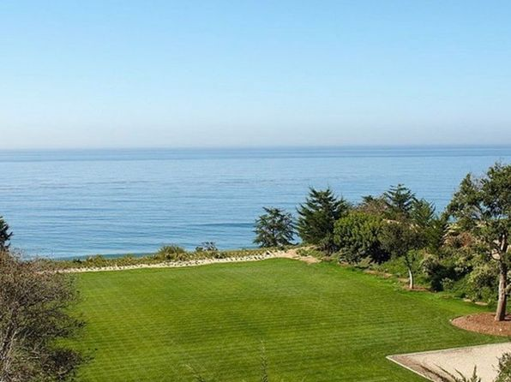
PLOs Are Precious Real Estate
PLOs should number about 5-7

Slide 24


Let’s REVISE and WRITE some PLOs...

Slide 25

Let’s ALIGN PLOs to program rubric...

Slide 26
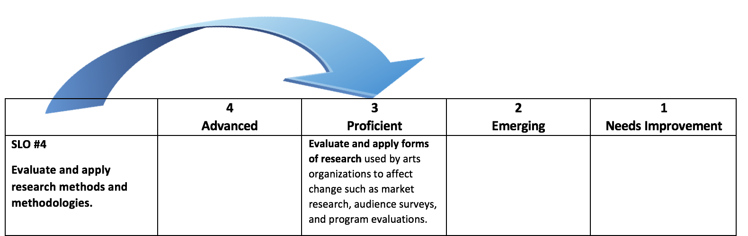
PLO should match to proficient.

Slide 27
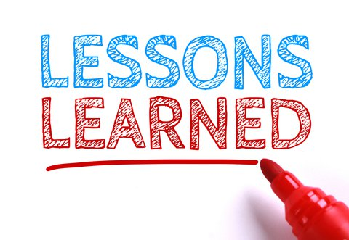
What we have learned...

Slide 28

Any Questions?

