Slide 1

It’s a(AI) new world out there!
Guest starring:
Sandra Leonard
Chair of English, former Composition Coordinator and Chair of Academic Honesty Committee
Erin Kraal
Director of Center for Engaged Learning, Professor of Physical Sciences
*Image generated via co-pilot prompt

Slide 2

What are critical skills in your field?

Slide 3

How do you see AI interacting with these skills?
Amanda Montañez for Scientific American

Slide 4

“All assignments are now AI assignments.”
Pg 198 Teaching with AI by Bowen and Watson
Discuss…

Slide 5
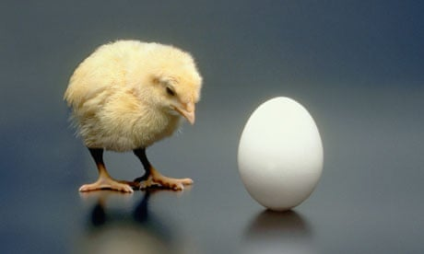
Where to start – syllabus or assignments?
Dennis Novak/Getty Images

Slide 6

KU AI policy guidance:
“Faculty should provide guidance on how students are permitted to use AI in their coursework, clearly stating permissible and impermissible uses. Students should adhere to these guidelines and seek clarification when uncertain.”
Kuztown University Policy GEN-008 Artificial Intelligence Acceptable Use Policy

Slide 7
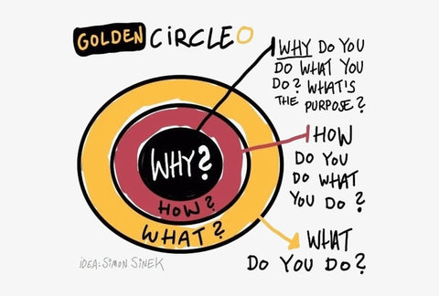
Start with WHY (Simon Sinek)
“However you proceed, start with the cookie, not the recipe. Before we pay attention to the details of any policy, we first need to understand why it matters for us. Starting with how a policy is going to help students learn and be better prepared for life will increase engagement and attention. If the policy aligns with the stated goals, you will get more understanding and compliance.”
Pg 135 Teaching with AI by Bowen and Watson (bolding mine)
Simon Sinek's 'Golden Circle' (2009)

Slide 8

Major takeaway from the joint MLA and CCCC Taskforce on Writing and AI
    “Focus on approaches to academic integrity that support students rather than punish them and that promote a collaborative rather than adversarial relationship between teachers and students.”
Visit https://aiandwriting.hcommons.org/working-paper-1/
to read the Working Paper

Slide 9

Tools to help think about the syllabus.
Materials-and-resources.jpg from CDC
Notes:
https://www.cdc.gov/disaster-epidemiology-and-response/php/tools-resources/index.html

Slide 10
Imagine the students…what’s this like for them?
Discuss how you think students feel/respond statements about AI?
What does it feel like for them to read your (ultimate) statement?

Slide 11

Maybe like this:
Remember – they have 5 classes (different professors, different fields, different….) to keep track of!
Image generated from a co-pilot prompt: create an image of college students looking a little confused in a class

Slide 12
Transitioning to Assignments
Dennis Novak/Getty Images

Slide 13

Effective assignments are linked to effective courses.
Assignment
Assignment
Assignment
Assignment
Assignment
Assignment
No amount of individual ‘assignment design’ can compensate if students don’t understand the course purpose and outcome.
Scaffold assignments within a course.
Assignment
Assignment
Assignment
Assignment
Course

Slide 14

I care, I can, I matter – these drive motivation for work
Motivation is most important when asking students to do cognitively harder, and generally more useful, types of studying like retrieval practice (Hui et al., 2022). Given the choice between harder and easier work, we need to understand the value of the added discomfort. Paying attention requires effort (hence the word “pay”). The motivational power of purpose (I care), self-efficacy (I can), and agency (I matter) can help us build assignments human students will want to do.
Chapter 10: Pg 186 Teaching with AI by Bowen and Watson
See table 10.1 for useful components
Kiwinberries etsy shop

Slide 15

Icare.Ican.Imatter
Choose one specific assignment in a course.
1. Jot down a brief description of this assignment (e.g. discussion post after reading a chapter, problem set following lecture, rough draft of research topic)

Slide 16
Icare.Ican.Imatter
Choose one specific assignment in a course.
1. Jot down a brief description of this assignment (e.g. discussion post after reading a chapter, problem set following lecture, rough draft of research topic)
2. Briefly describe the students in the course. (e.g. pretty much all freshmen in the major, GenEd students from all majors/years, seniors about to graduate)
3. Explain to those students WHY this assignment is important

Slide 17
Icare.Ican.Imatter
Now – write a quick note about what students need to think about or know regarding AI and this assignment.

Slide 18
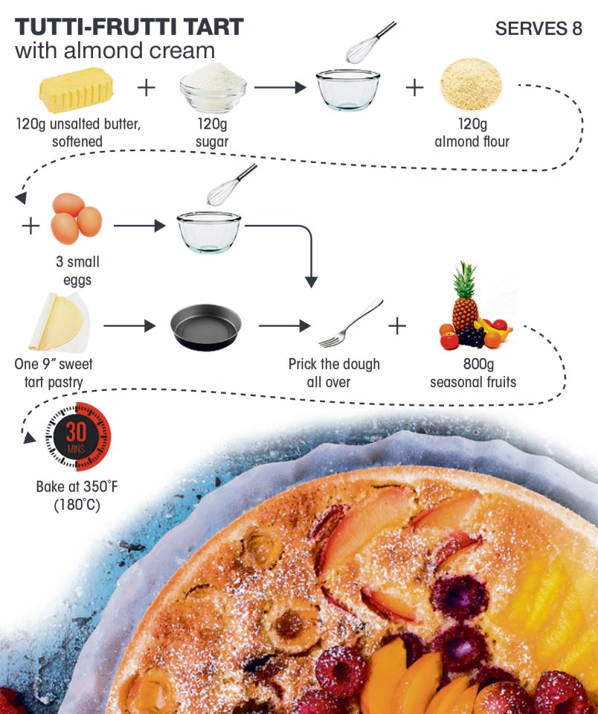

Build in documenting the process
Attribution statements
Citations
Coversheets (not just for writing assignments!)
Surveys
Reflections

Slide 19
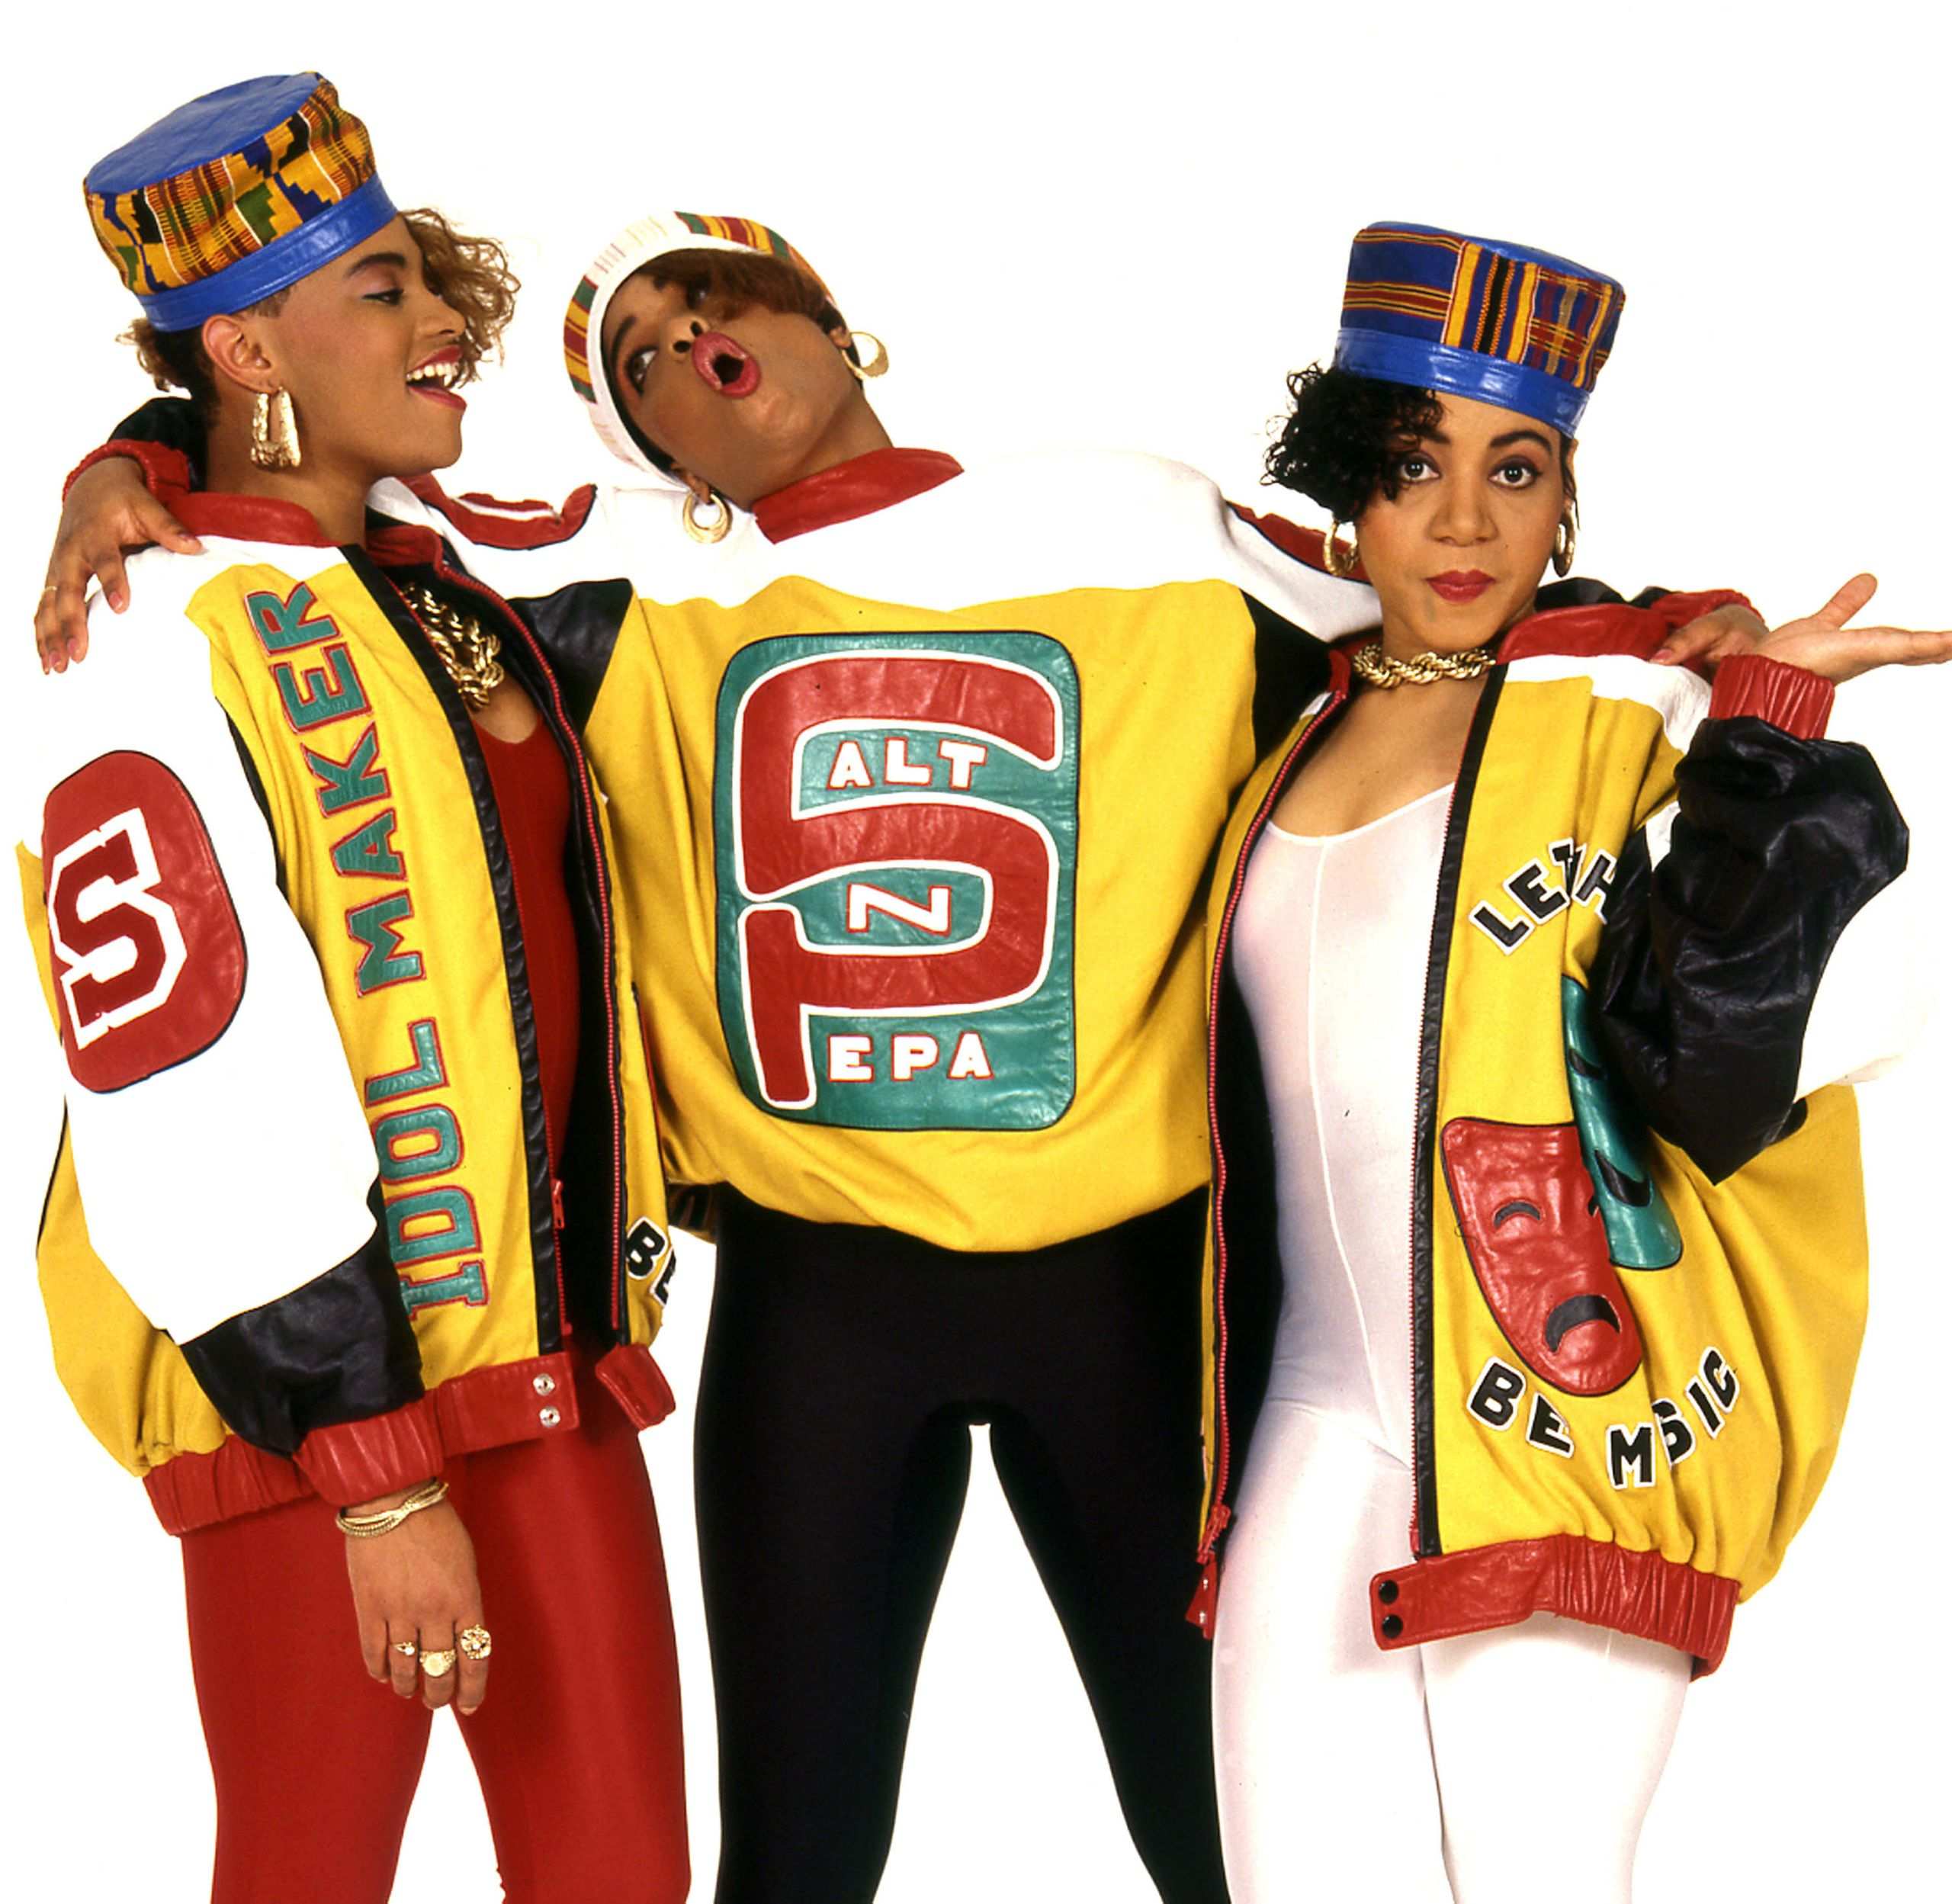
Let’s talk about cheating baby…
Photo: Janette Beckman / Redferns / Getty Images

Slide 20
What does it mean when students ‘cheat’?
Why do students cheat?

Slide 21

“…tackling the reasons, rather than the behaviors, is the solution.”
Gallant and Rettinger in The Opposite of Cheating

Slide 22

Three Tips from an Academic Honesty Expert

Slide 23
#1 Clear Expectations
Have a syllabus policy that covers your expectations regarding A.I. use and source use.
Repeat that policy on assignments.
Give examples of ethical source use in your discipline

Slide 24
#2 Engage with student work
Students generally cheat when they believe their work doesn’t matter or is not being read. So, having students share work through peer review and conferencing makes it clear that a human* is reading their work.
*Transparency goes both ways: if you use A.I. in any part of your evaluations or course materials, it's important to fully disclose this use.

Slide 25
#3 It’s Teaching!
Academic honesty/plagiarism/AI is actually a fun and intellectually-rich topic to talk about! Students love to talk about breaking norms and cheating. Talk about copyright and plagiarism in society, politics, music…

Slide 26

What is your take-away for AI?

