Slide 1
Metacognition and Reflective Thinking Practices
New Faculty Orientation
Dr. Amy Lynch-Biniek, Department of English
Dr. Andrew Mashintonio, Department of Biology

Slide 2
  Reflection is a tool for learning.
  Reflection is a tool for improving teaching.
  Reflection helps students “to assess which skill and knowledge sets apply in…
  novel situations and which do not….it is metacognition that endows writers
  with a certain control over their work.”
  ~ Howard Tinberg, “Metacognition Is Not Cognition,” in Naming What We Know
Notes:
Amy: While teachers and students both often associate reflection with sorting through feelings, we’re focusing on how you can use reflection--that’s metacognition to you and me, or thinking about thinking--as a vehicle for encouraging student’s growth by asking them to assess their knowledge sets, approaches to tasks, and habits of mind.

Slide 3

Introductions... a bit about our stories...
Notes:
Andrew: I am starting my 10th year at KU, but like some of you I was a temporary faculty for 5 years before being converted to the tenure track a little over 4 years ago. As a temp I focused mostly on teaching with some service and scholarship sprinkled in. As I transitioned into this new role, I felt that I had a good teaching foundation built already and could focus more on scholarship and research now. But of course, in this new role I received new teaching assignments, also proposed and built brand-new courses, all this while increasing service, increasing research, and advising, AND while raising 4 kids under 12 years old with my wife, 3 guinea pigs, and a new puppy last year. So it can feel overwhelming to try to incorporate innovative teaching practices into your courses with everything else you've got going on. So shortly I'm going to focus on some strategies you can use in classes that address the idea of metacognition, or thinking about thinking, with your students.
Amy: I’m starting my 20th year at KU. I’m a writing teacher and served as writing center director, later composition coordinator, assistant department chair, and now, after many years, I’m just a prof again. While while my own focus is writing, I’m going to share some techniques you can use even if you never assign writing in your course. Andrew is growing to begin by showcasing some of the reflective assignments he uses in his courses.

Slide 4

Theories of Intelligence
Notes:
Andrew: I'm going to start off here with an assignment I give my students, both in biology majors classes and for non-majors, about the theories of intelligence. At the end of the first class I give them this survey to answer, it's only 7 questions so it shouldn't take you too long. Just read them carefully because they are similar, but worded sometimes differently. When you finish, it will automatically score your answers, so hang onto this score.
[Check responses as they come in, after a minute can go to next slide]

Slide 5






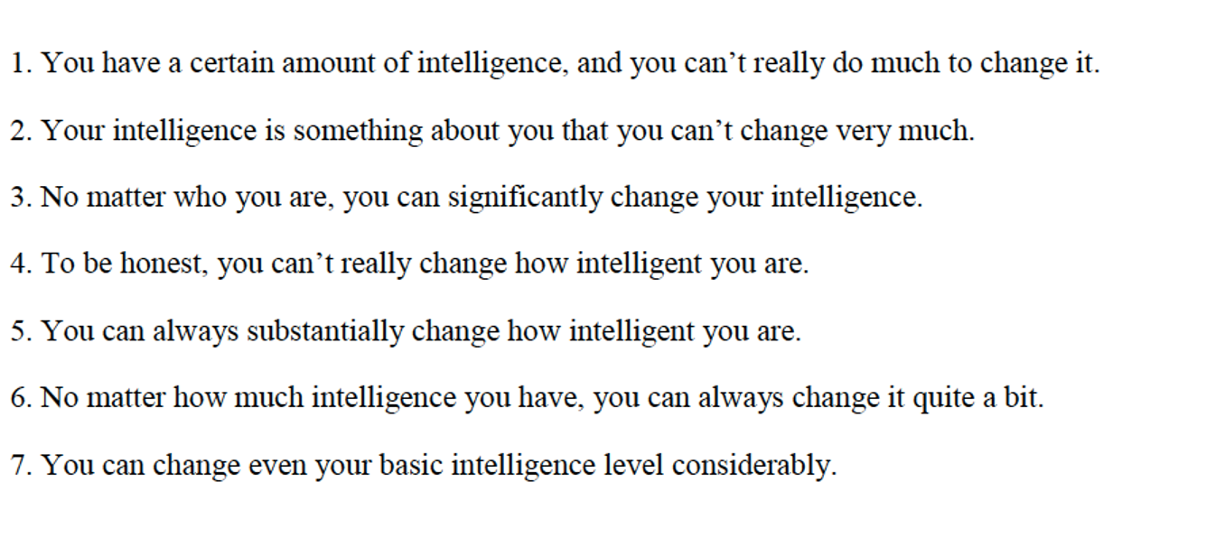
Theories of Intelligence
Notes:
I have a handout here of this assignment [pass around while they take the survey], so they do the survey by hand and then bring it back the following week. Scores are based on how strongly you agree with the idea that intelligence is not fixed. Possible scores range from 7 to 42. Scores below the midpoint of 24.5 reflect the belief that one’s intelligence is fixed (entity theorists); scores above 24.5 indicate the belief that one’s intelligence is malleable (incremental theorists). Looks like the average in the room is a [number], so you all are generally [x].
For the assignment, students read the two articles in the packet and then answer some questions on D2L. The following week they discuss this in class. This assignment has ulterior motives. Research has shown that having a discussion on the development of intelligence early on in college can actually have a substantial impact on how successful students are in the rest of their undergraduate studies.
The thought process is that many people believe that intelligence is a fixed value (entity theory) and therefore you can’t get any smarter. This leads many students to believe that having to work hard at something means that they aren’t smart, and a poor grade on an assignment or test means that they are stupid and will never do better so why bother.
People who believe in the incremental theory, where it is possible to increase your intelligence, will be more likely treat struggles as learning experiences and be proud when they overcome those struggles.
The key for this intervention is that you can’t just tell students that if they work harder they will get smarter. (Remember when you were a teenager. How much did you listen to stuff like this?) The goal of this exercise is to introduce the idea that it is possible to get better at something (and therefore smarter), but that the improvement requires a certain kind of work to be successful.
If you are interested in these studies, Carol Dweck and David Yeager have published several articles on implementing these interventions with students of various ages.

Slide 6
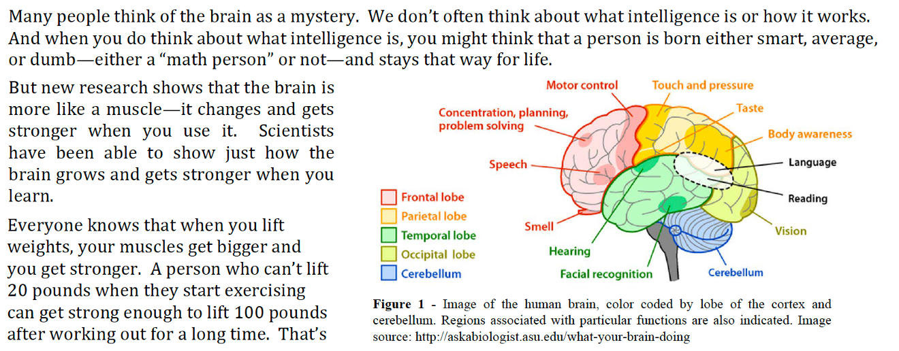
You Can Grow Your Brain
Notes:
No time today to have you read and discuss these articles, but a really quick recap:
What were the main points of the first article?
When you work hard and learn new things, you are increasing the number of connections between neurons in your brain (synapses). The more you challenge yourself, the smarter you become. Being “smart” means that you have practiced more and developed those skills.
Figure: diagram of the brain with different regions highlighted to demonstrate their functions.

Slide 7
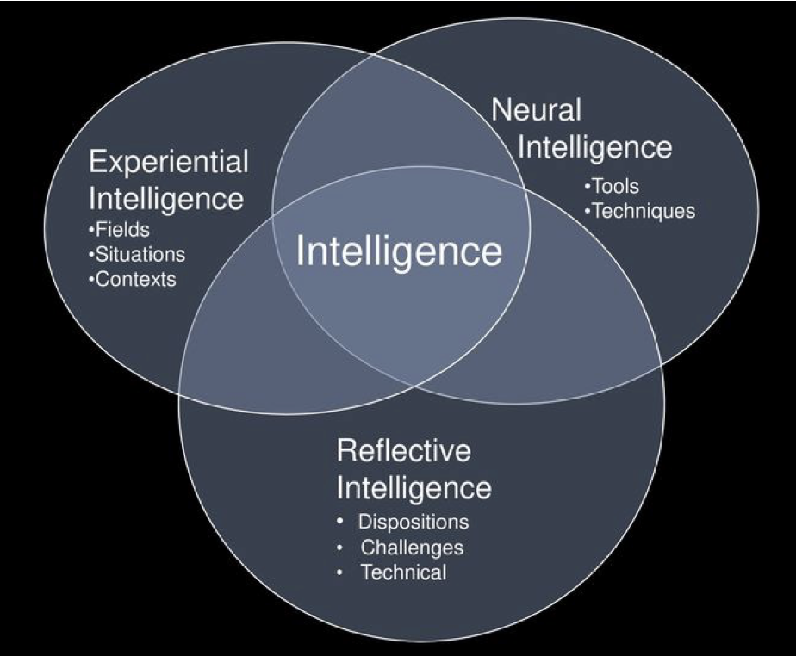
Mindware and the Metacurriculum
Notes:
What were the main points of the second article?
There are different aspects to intelligence (reflective, experiential & neural), and these factors all contribute to overall intelligence. Neural: base level, what you're born with. Experiential – what you learn through experiences in life. The reflective aspect can be improved in order to make the learning process more efficient. Practice is important, but doing things over and over again the same way won’t lead to much improvement.
Figure: diagram displaying the characteristics of the three aspects of intelligence.

Slide 8
Theories of Intelligence
In groups, compose a short letter to a friend that has been struggling with school. This friend used to do pretty well in school, but now is having a hard time and as a result feels kind of dumb. Based on what we’ve learned from these articles, provide them some encouragement and suggestions for the future.
Notes:
I then end class with this prompt, which itself is another type of self-reflective activity that I'll discuss next.

Slide 9
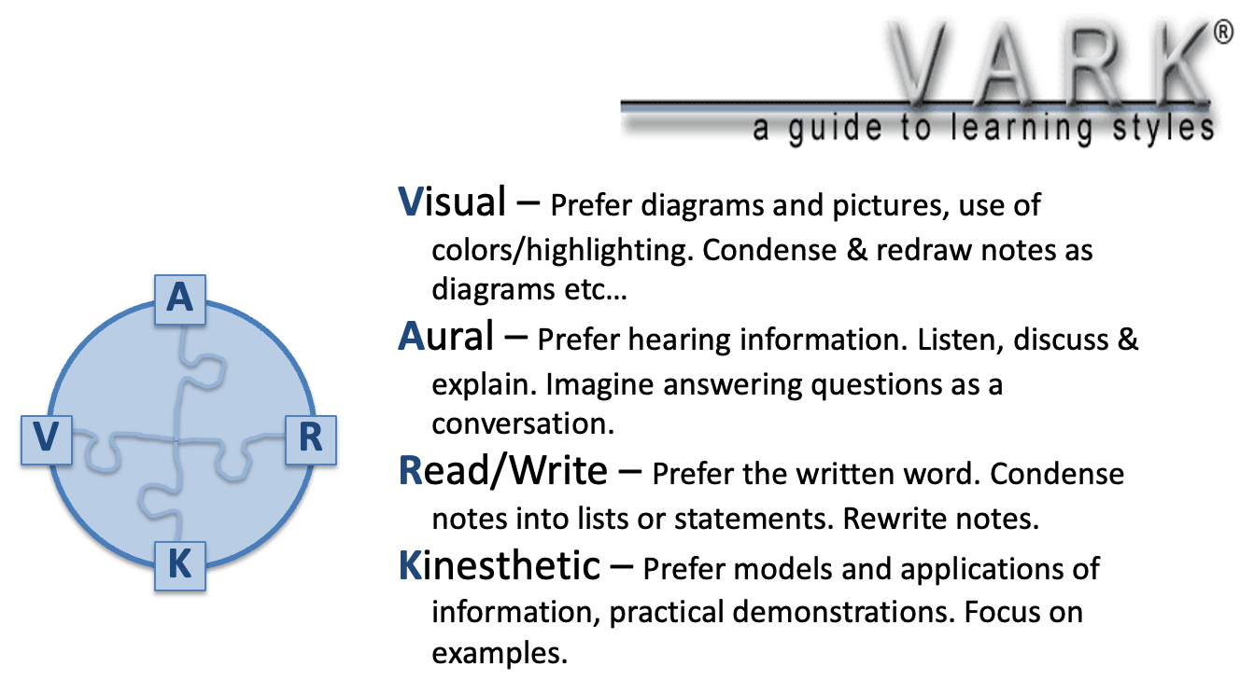
Reflective Journals/Essays
Identify your VARK leaning style:
http://vark-learn.com/the-vark-questionnaire/
Describe how you typically prefer to
learn the material. Does this align with
the results of the VARK questionnaire?
Will you change your study strategies?
Notes:
These tools, widely used in some other disciplines but less often in STEM fields, again encourage students to consider what, how and why they learned, as well as how their identity interacts with the course. They might involve writing a letter to a former self or to consider what they might have done differently to perform better in the classroom (Tanner 2012). Last activity is a great example!
This one here I have also used in the past, it is one of the first of the semester and it gets students to consider how they learn the best. There are four learning styles, listed here, and students take a survey to see how they learn the best. It can identify multiple preferred styles and then provides resources and explanations for utilizing the best strategy for each student. It also makes me aware of the multiple different learning styles among my students, so I try to make the course material available in a variety of different formats (example w/ nutrition, if asked).

Slide 10
Exam Wrappers
For the following questions , indicate how much you agree with the statement.
1. Since the last exam, I have typically done the textbook reading before lectures on the material.
A. Strongly agree B. Agree C. Neither agree not disagree D. Disagree E. Strongly disagree
2. Since the last exam, I have attended lecture almost all the time.
A. Strongly agree B. Agree C. Neither agree not disagree D. Disagree E. Strongly disagree
3. Since the last exam, I have done the homework consistently, without looking up answers online or resorting to repeated rounds of guessing.
A. Strongly agree B. Agree C. Neither agree not disagree D. Disagree E. Strongly disagree
4. I know how I should effectively study/prepare for exams in this class.
A. Strongly agree B. Agree C. Neither agree not disagree D. Disagree E. Strongly disagree
Notes:
These involve providing students with reflective questions immediately before and after an exam, and encourage students to consider their expectations for the exam, their preparedness, and, afterwards, the ways their expectations regarding the exam may differ from the reality (Hodges et al. 2020). Can also be done as a mid-semester survey, which I also do frequently.

Slide 11
Writing is a knowledge-making activity
“We don’t simply think first and then writer. We write to think.”
~Heidi Estrem, “Writing Is a Knowledge-Making Activity” in Naming What We Know
Writing can lead to new insights.
Reflections are dedicated thinking-time.
Notes:
Amy: As I noted earlier, I teach primarily teach writing, but I think much of what I’m sharing applies across assignment-types.

Slide 12
Reflections & the Curse of Knowledge
Choose a writing assignment that you’ve seen students struggle with. It might be a full-blown writing project or a short response in an exam.
Imagine you are completing that same assignment. Focus not on the content, but on how you construct the piece of writing. Take some notes:
What are the key moves you need to make?
How do you organize it? Do you reorganize? What does that look like?
What are the steps in your revision and editing processes?
Notes:
Amy: As teachers, we need to reflect as well. You may be familiar with “the curse of knowledge,” the cognitive bias where individuals, once they possess knowledge, find it difficult to understand what it's like to not know that information. This can make teaching challenging. For example, we might have so internalized a process of problem-solving, analyzing, or writing, that we forget that we need to break it down into steps for the beginner.
For instance, in a writing assignment, we might assume that students know specific ways of interacting with sources, because these moves have become second nature to us. Metacognition helps us to identify those moves & better articulate them to students.
Let’s do some reflection.

Slide 13
Writing and Metacognition
Students don’t often reflect on how or why they created, processed, or wrote something as they did.
They may be using writing and thinking moves that have become second nature, even if they aren’t useful or applicable to the current situation.
Reflection after an initial draft:
What sections or moves did you include in the introduction of your report?
Why did you choose to include them? What function do they serve?
Compare the moves you made to the sample intro provided by the prof. How do they differ?
What changes, if any, will you make to this section in your next draft?
Notes:
Amy: This same approach to reflection works with students. Students don’t often reflect on how or why they created, processed, or wrote something as they did. They may be using writing and thinking moves that have become second nature, even if they aren’t useful or applicable to the current situation.
In COMP 100, a lot of what I do is teach students that the 5-paragraph essay is not useful in every writing context.
I’ll remind you of a quote from Tinberg on an earlier slide. Reflection helps students “to assess which skill and knowledge sets apply in…novel situations and which do not.”
This example is one I wouldn’t grade or even collect. I’d just ask students to pull out a notebook and do some writing in class, and we might discuss the results as a whole class, too.

Slide 14
Reflection encourages better work.
After guided reflection:
  Writers can adjust and adapt as they understand where, how, and why things went wrong, or store new tools and moves into their long-term memories for use in future situations.
  Writers who reflect often make “deeper choices” and are more likely to revise.

Slide 15
Examples from COMP 200: Research & Composition
I asked you to locate six sources of specific types and from specific platforms. What have you learned or practiced regarding the tools for locating research, including elements such as: keywords, library databases, filters, googling, using local resources, and working with a librarian? Use at least one specific example from your own work to explain.
What have you learned or practiced regarding the process of assessing the ethos or credibility of sources and locating a diversity of perspectives? Please reference specific concerns or approaches we have reviewed in class and describe at least one specific example from your own work as you explain your practice.
What have you learned or practiced regarding interacting with research in more sophisticated ways? Think about the writing tools we worked with, like synthesizing, forwarding, and countering; balancing your voice with research; and attributing sources. Where do you think you improved or excelled? What do you still need to practice? Point to examples in your writing.

Slide 16
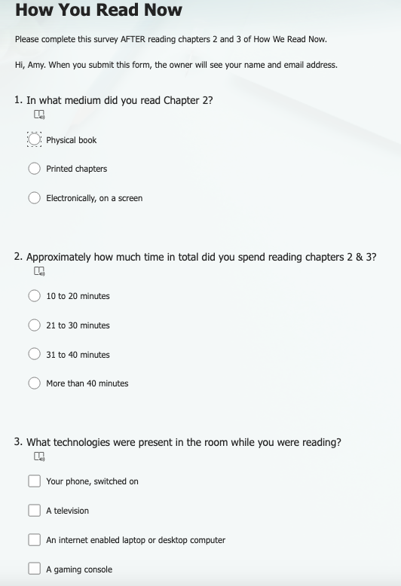
Reflection on Reading Habits
ENGL 248: Living Literacy
Survey of student approaches to their own reading of a chapter about reading strategies.
https://forms.office.com/r/fcxkhsWNy9

Slide 17

Assigning Written Reflections
We need to teach and guide reflection—students don’t inherently know how best to reflect.
Ask students to reflect in the early stages of a project as well as at the end.
Identify the critical learning moments you want students to focus on
  Example: study habits, taking notes during class, exam performance, writing moves, genre conventions, processes
  Review your SLOs if stuck
Identify areas that will help your students address their learning behaviors

Slide 18

Assessing Reflections
Focus on the big picture
Acknowledge process limitations
Provide feedback with the goal of making the student open up on the next reflection
Remember that thinking is messy and so reflections may be messy, too.
Notes:
Challenge: large-enrollment classes, makes it difficult to provide feedback. Options: respond to random subset for each reflection, pre-generated feedback on D2L, grades based on attempt/completion and not something more specific... Just getting students to reflect can provide some benefits, so doing something is better than not doing it at all.
Also, remember: not everything must be graded to be valuable.
Figure: face looking inward at the rest of the head.

Slide 19

Muddiest Point
Consider what we covered during today's lecture (or anything from orientation).
  List one thing you knew before class, one thing you learned during class, and one thing you still are unsure of.
  Discuss this list with your neighbors. Specifically, see if a neighbor can answer any questions you still have about the material!
Notes:
Andrew: Often ask for responses from the class regarding #3, time permitting.
Or if short on time, have students submit questions to D2L. See where the class is at, if there are common things students have questions about. Maybe use AI to look for trends? Can then address this more directly the next class.
Other alternatives: List three questions you have about today's material. If you think you understand everything from today, list three questions about things you still want to learn related to today's material.

Slide 20
Thank you!
lynchbin@kutztown.edu
mashinto@kutztown.edu

